Slide 1




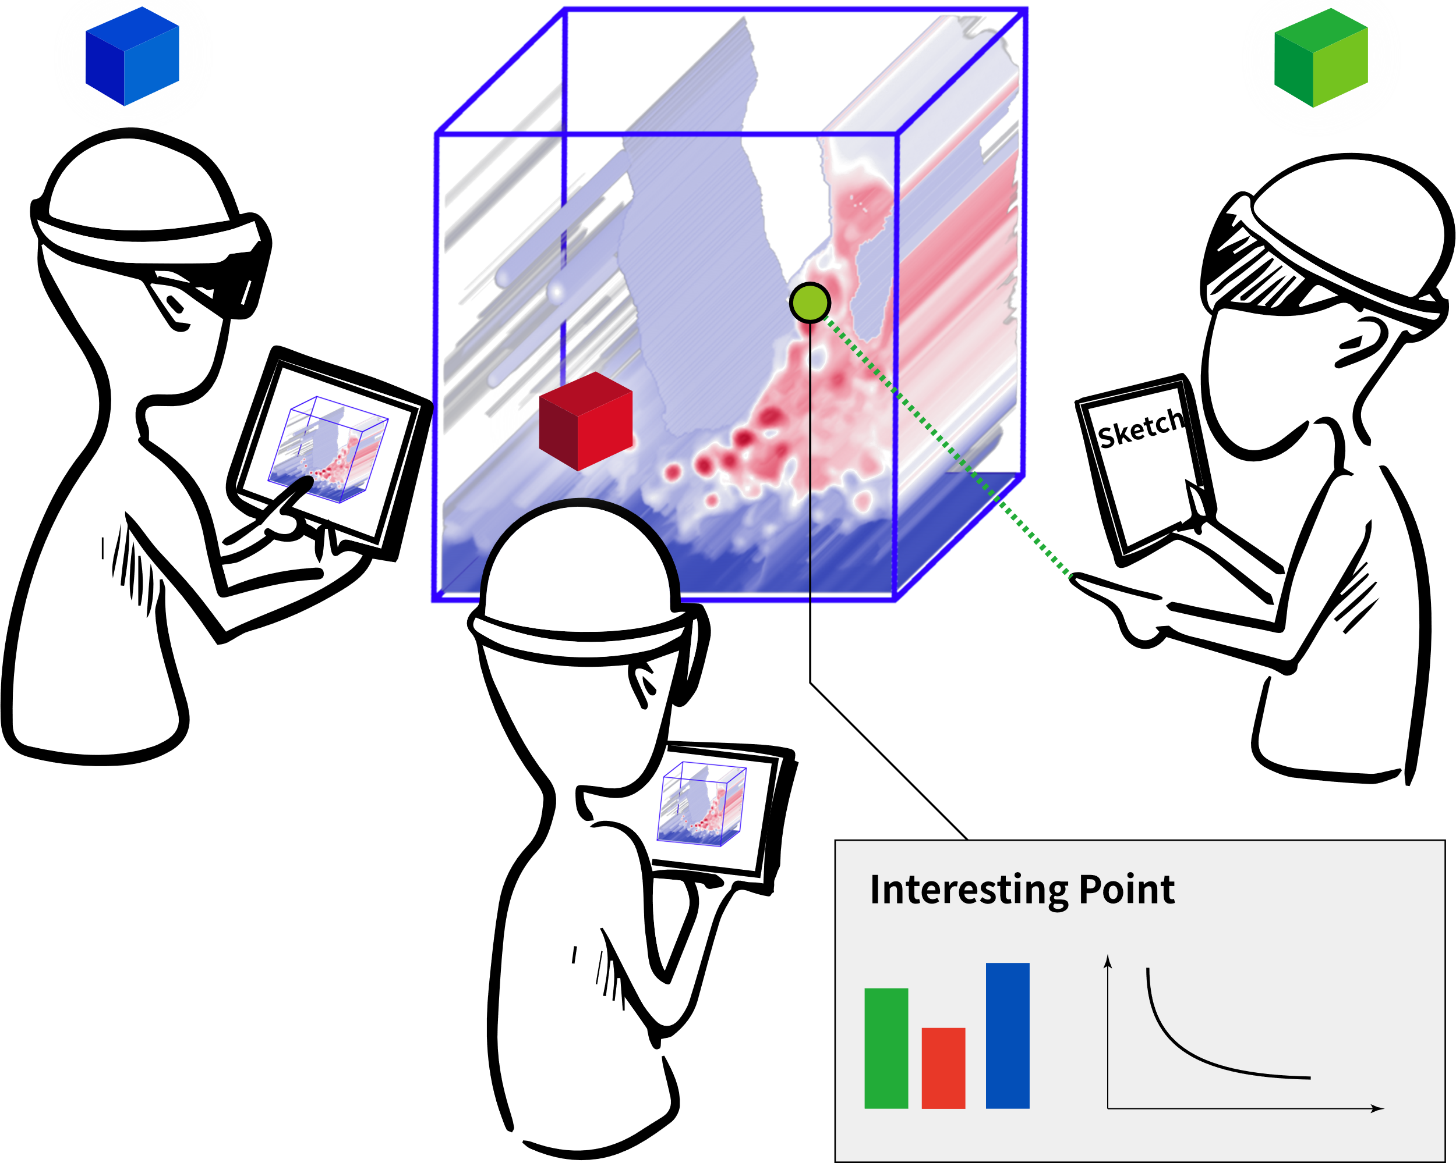
Collaborative Data Exploration and Discussion with Augmented Reality Support
Mickaël Sereno, supervised by Tobias Isenberg

Slide 2
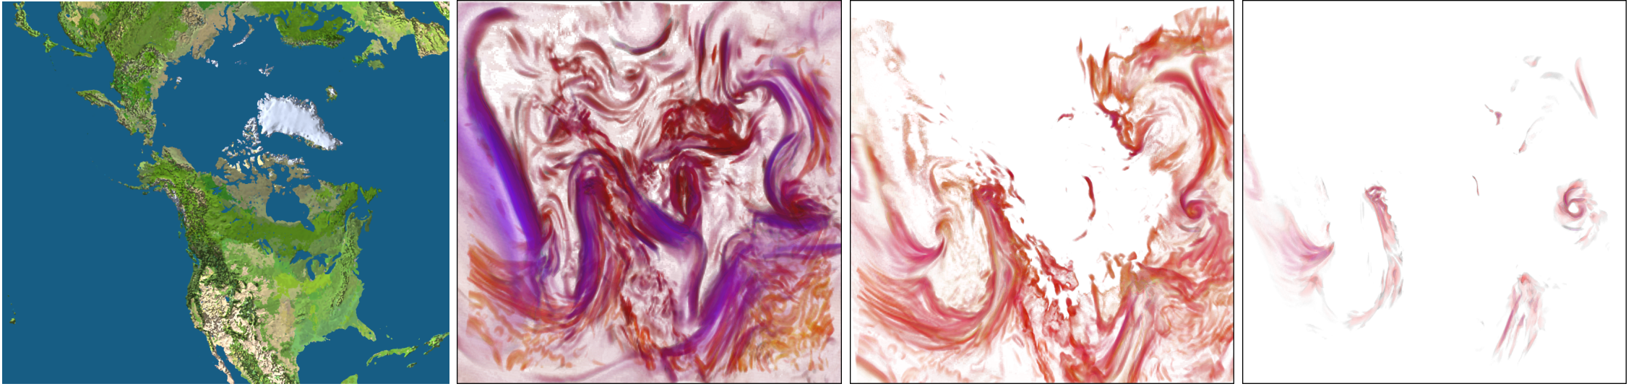

What are Data Visualization and Data Exploration? Visual Analytics
Kniss et al., “Gaussian transfer functions for multi-field volume visualization,” 2003
Context Map
Extract Air Mass Front
Extract Air Mass Front
Of Strong Wind
Variables: temperature, humidity, wind speed
Immersive Analytics
Notes:
Front: transition zone between air masses with distinctly different properties.

Slide 3


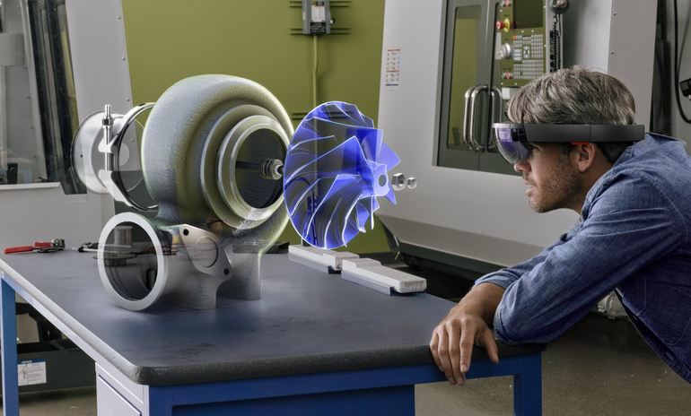
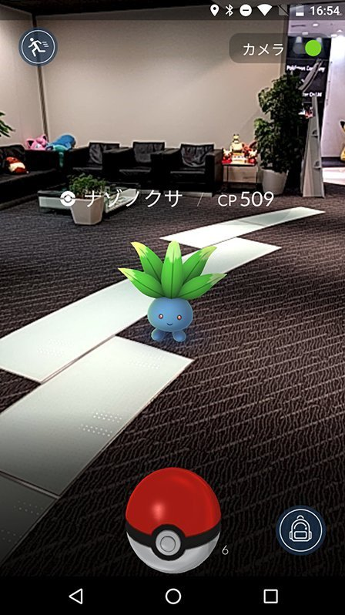
What is Augmented Reality (AR)? Merge virtual and real
Microsoft
Pokémon Go
Piper et al., “Illuminating Clay: A 3-D Tangible Interface for Landscape Analysis”, 2002

Slide 4


How to start this PhD? Reading Surveys and Summaries
Kim et al. “Revisiting trends in augmented reality research: A review of the 2nd decade of ISMAR (2008–2017),” 2018
N(AR-CSCW) = ε
Past surveys either:
Focus mostly on scenarios
Do not consider the technological breakthrough of 2016
Microsoft

Slide 5
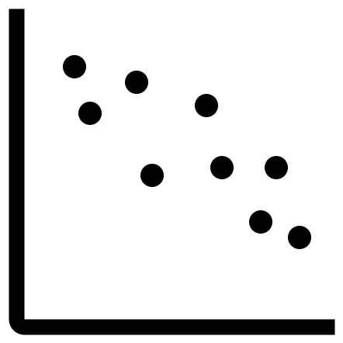
At the Beginning, a Survey (TVCG 2020) Mickaël Sereno, Lonni Besançon, Xiyao Wang, Michael McGuffin, Tobias Isenberg
Focus on technological aspects
Discuss about Immersive Analytics

Slide 6
At the Beginning, a Survey (TVCG 2020) Method: 18 + 50 → 68 papers
Should describe an AR system
Systematic: main AR and “collaborative” conferences: IEEE ISMAR and ACM CSCW
Opportunistic approach:
To add key contributions
To exemplify multiple aspects
Systematic (2008 – 2019)
ISMAR: 12
CSCW: 6
Opportunistic
2008 – today : 35
Before 2007: 15

Slide 7


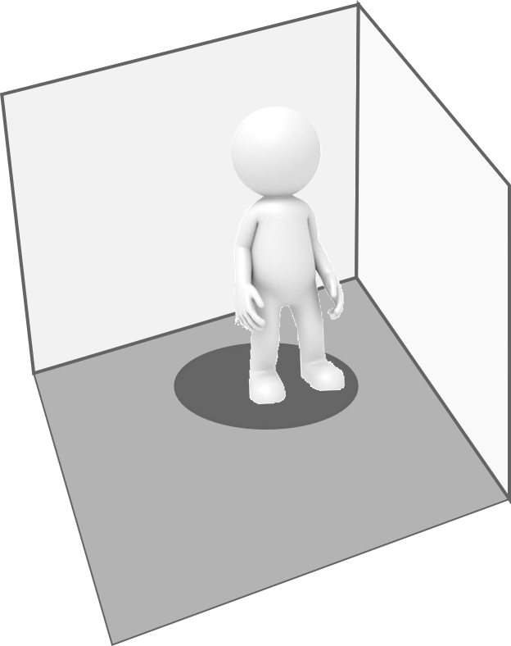

At the Beginning, a Survey (TVCG 2020) Background and Taxonomy
68
Space and Time
Co-Located vs. Remote
Synchronous vs. Asynchronous
Technology and Role Symmetry
Input and Output devices
Ens et al., “Revisiting collaboration through mixed reality: The evolution of groupware,” 2019
AR
Non-AR
AR-HMD | Hand-Held Display | SAR | VR-HMD | 2D screen | CAVE

Slide 8
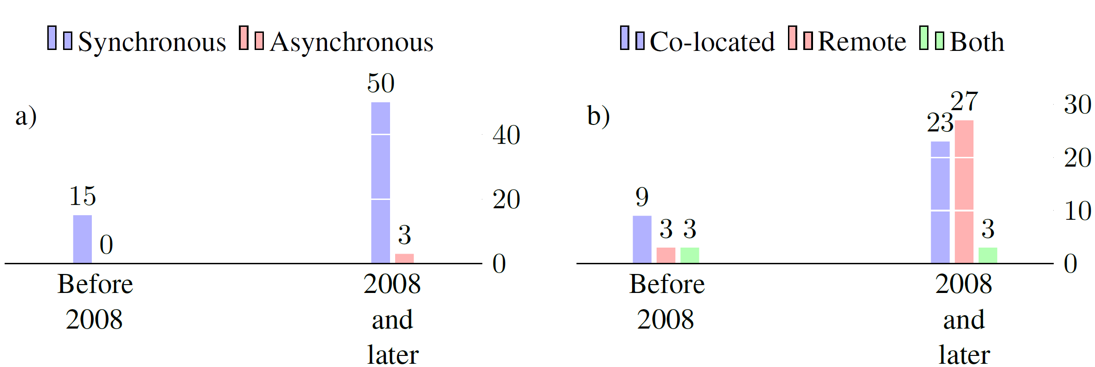
At the Beginning, a Survey (TVCG 2020) Some Metrics
Almost no async. Papers (annotating real env.)
Shift from Co-Located to Remote over the years
~78% of Remote → partial or asym. tech.
Focus mainly on communication
39 papers (~58%) 21 (~31%)

Slide 9
General Guideline: Role and Hardware
2D screens:
Used by experts to remotely guide a partner
Engage passive non-AR users
Common support for 2D information
Provide 2D usual tools

Slide 10


General Guideline: Awareness: understanding of another’s interaction
EMBODIMENT
Should reach the workspace
Awareness cue
User A
User B
Workspace

Slide 11
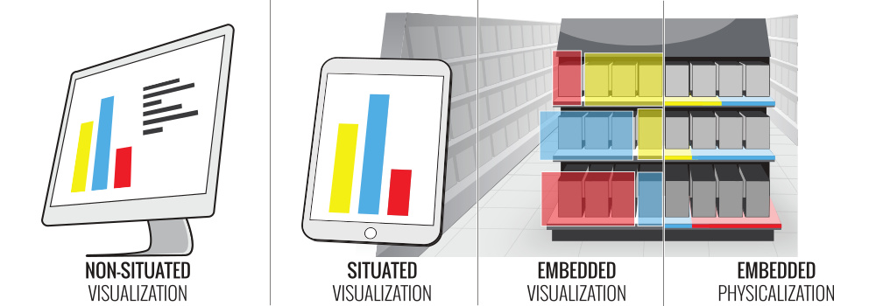
Collaborative Immersive Analytics Billinghurst et al., “Collaborative immersive analytics,” 2018
N(Analytics_VR) >> N(Analytics_AR)
A. Fonnet and Y. Prié, “Survey of immersive analytics,” TVCG, 2019
Small screen, less powerful than workstations, no immersion (e.g., stereoscopy)
Willett et al., “Embedded Data Representations”, TVCG, 2016
Like the CAVE (but more constraints)
Before 2016: Not enough computing power, need higher refresh rate

Slide 12
Collaborative Immersive Analytics Billinghurst et al., “Collaborative immersive analytics,” 2018
N(Analytics) = ε
N(Analytics_VR) >> N(Analytics_AR)
A. Fonnet and Y. Prié, “Survey of immersive analytics,” TVCG, 2019
Small screen, less powerful than workstations, no immersion
Like the CAVE (but more constraints)
Before 2016: Not enough computing power

Slide 13




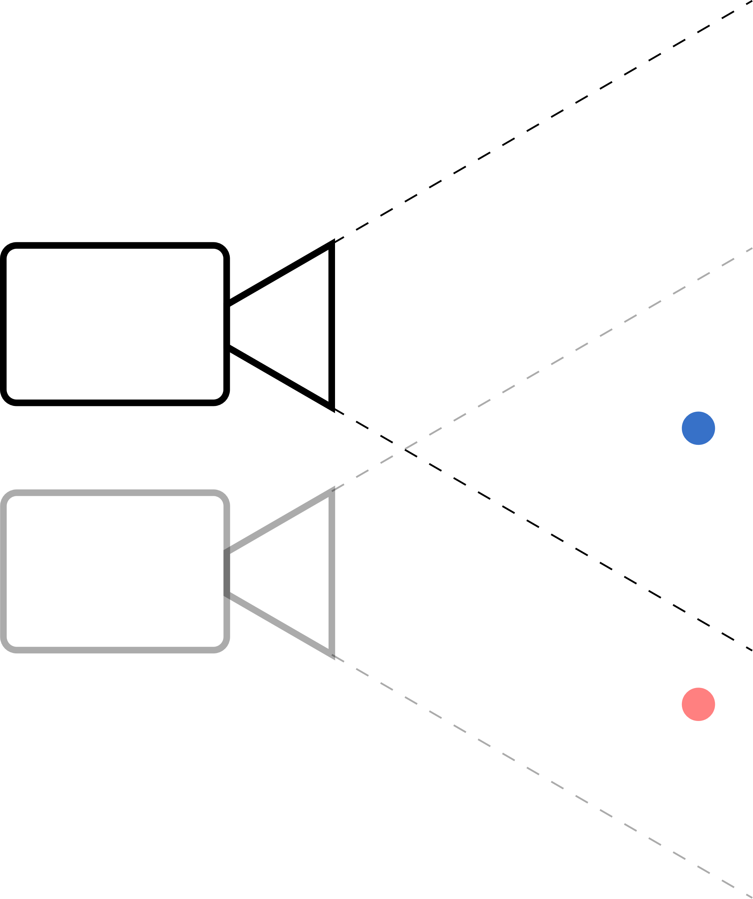


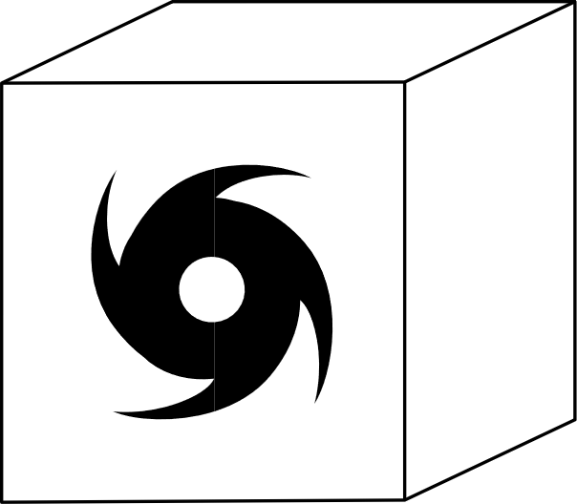
Head-Mounted Displays as AR devices
RQ: What are the benefits and limitations of AR-HMDs for collaborative 3D data exploration?
3D
Visualization Interaction Collaborative
Physical Space

Slide 14
Collaborative Co-Located 3D Data Exploration and Discussion with Augmented Reality Head-Mounted Displays Support.

Slide 15
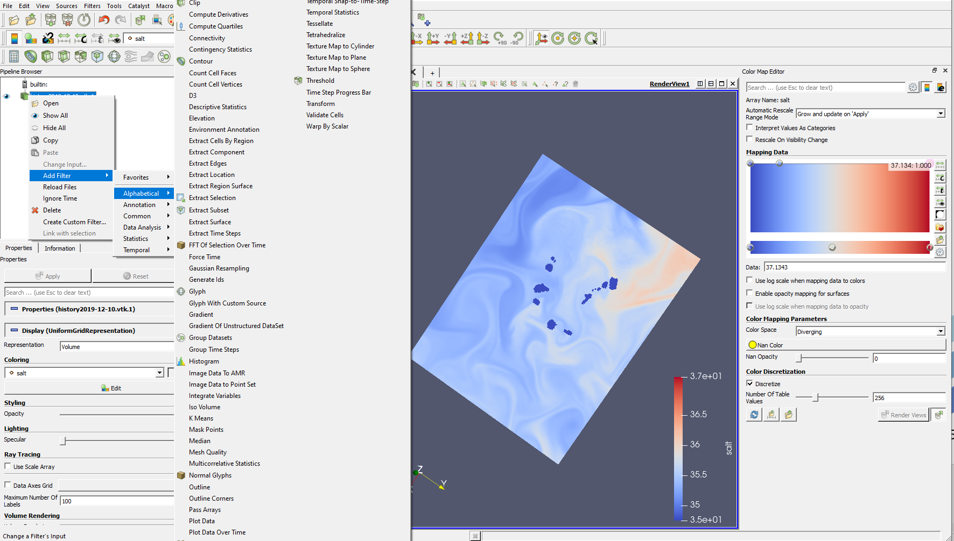
Headsets and Interactions The need of NUMEROUS exploratory tools
ParaView, Kitware

Slide 16


Head-Mounted Displays and Interactions The available interfaces
Speech
Gaze
Mid-air gestures
Confusing
Discrete Interaction
Limited
Continuous interaction
Tiring (Gorilla Arm effect)

Slide 17

Head-Mounted Displays and Interactions Hybrid Environment
Survey:
10 standalone
29 hybrid
Breaks Collaborative Space

Slide 18

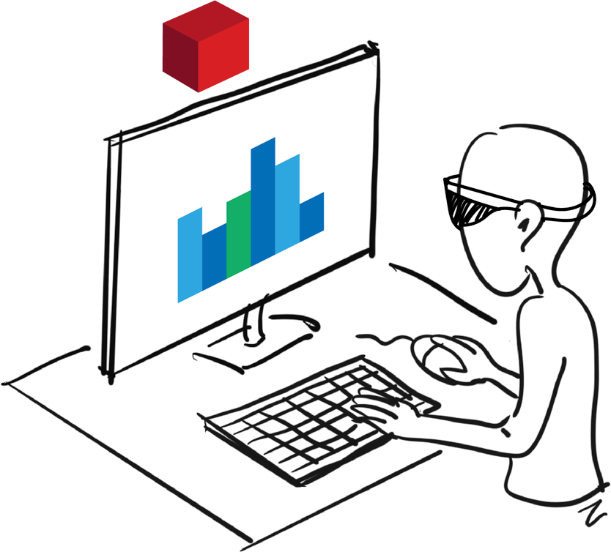
Head-Mounted Displays and Interaction Hybrid Environment
X. Wang, L. Besancon, D. Rousseau, Mickael Sereno, M. Ammi, and T. Isenberg, “Towards an understanding of augmented reality extensions for existing 3D data analysis tools,” CHI, 2020
Benefits
Keyboard
Computing Power
Limitations
No collaborative space
Not mobile

Slide 19


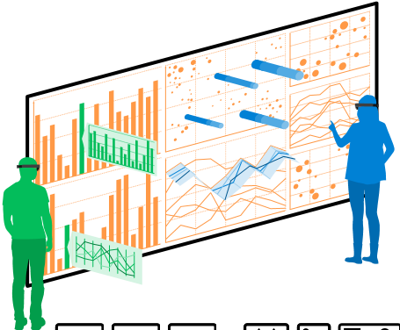
Head-Mounted Displays and Interaction Hybrid Environment
Reipschlager et al., “Personal augmented reality for information visualization on large interactive displays,” 2020
Benefits
Touch input
Large workspace
Public 2D screen
Require only one additional device
Limitations
Expensive, static
Tradeoff between size and personal interactive space
Keyboard
Require movements

Slide 20
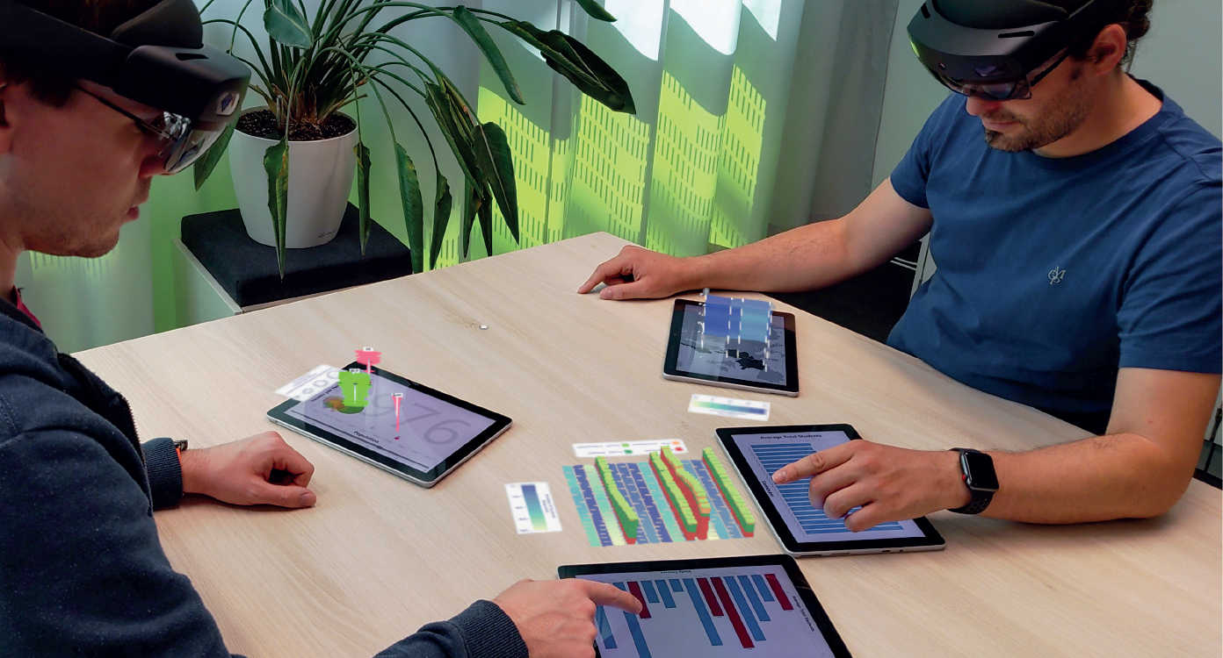
Head-Mounted Displays and Interaction Hybrid Environment
Büschel et al., “MIRIA: A Mixed Reality Toolkit for the In-Situ Visualization and Analysis of Spatio-Temporal Interaction Data,” 2021
Benefits
Touch input
Tangible (3D) input
Mobility
Personal device
Limitations
Computing Power
Keyboard
Public space

Slide 21
But Collaboration First Headsets +Tablets
RQ1: How complementary can multi-touch tablets and AR-HMDs be to collaboratively explore 3D data?
Scenarios
Data pre-processed (scripting)
For collaboration
3D visualizations are the focus
Computing power
≈

Slide 22
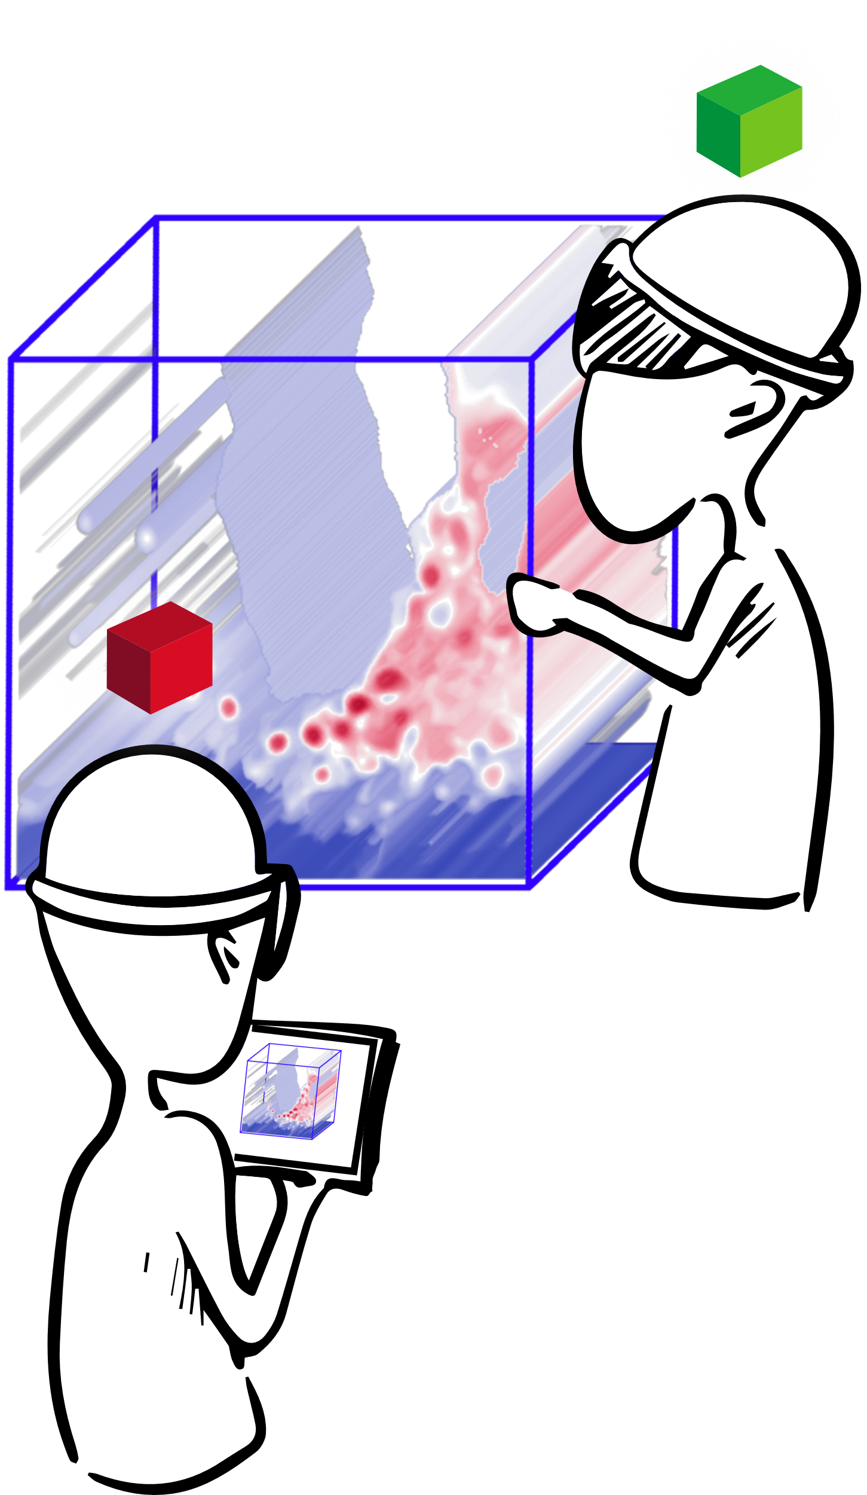
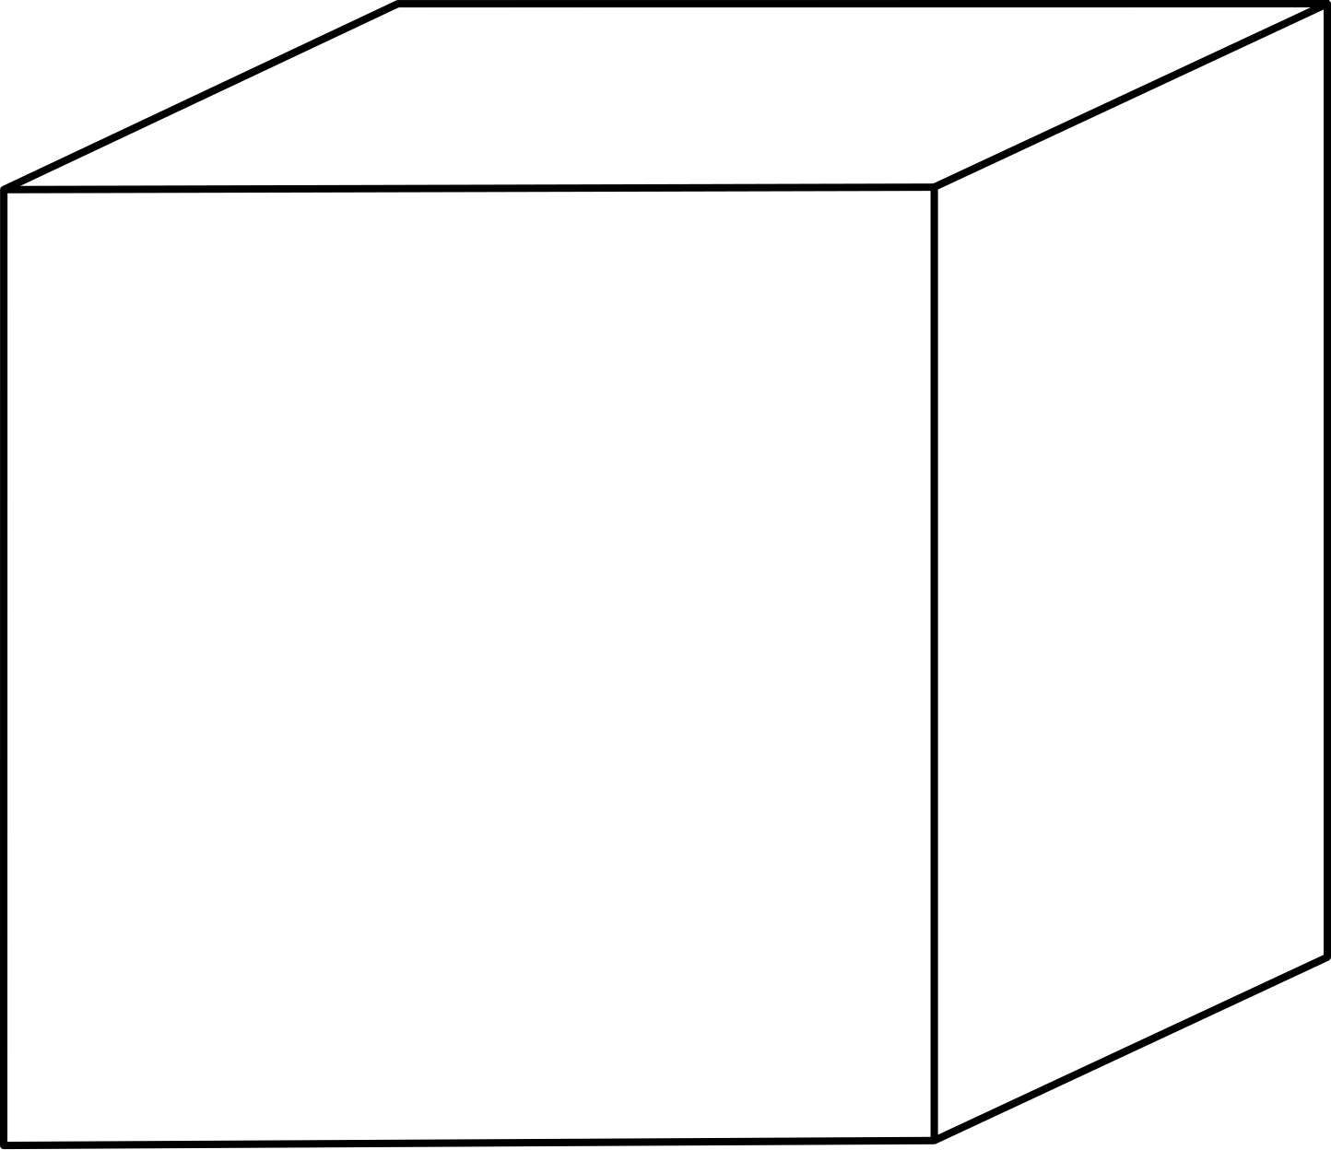
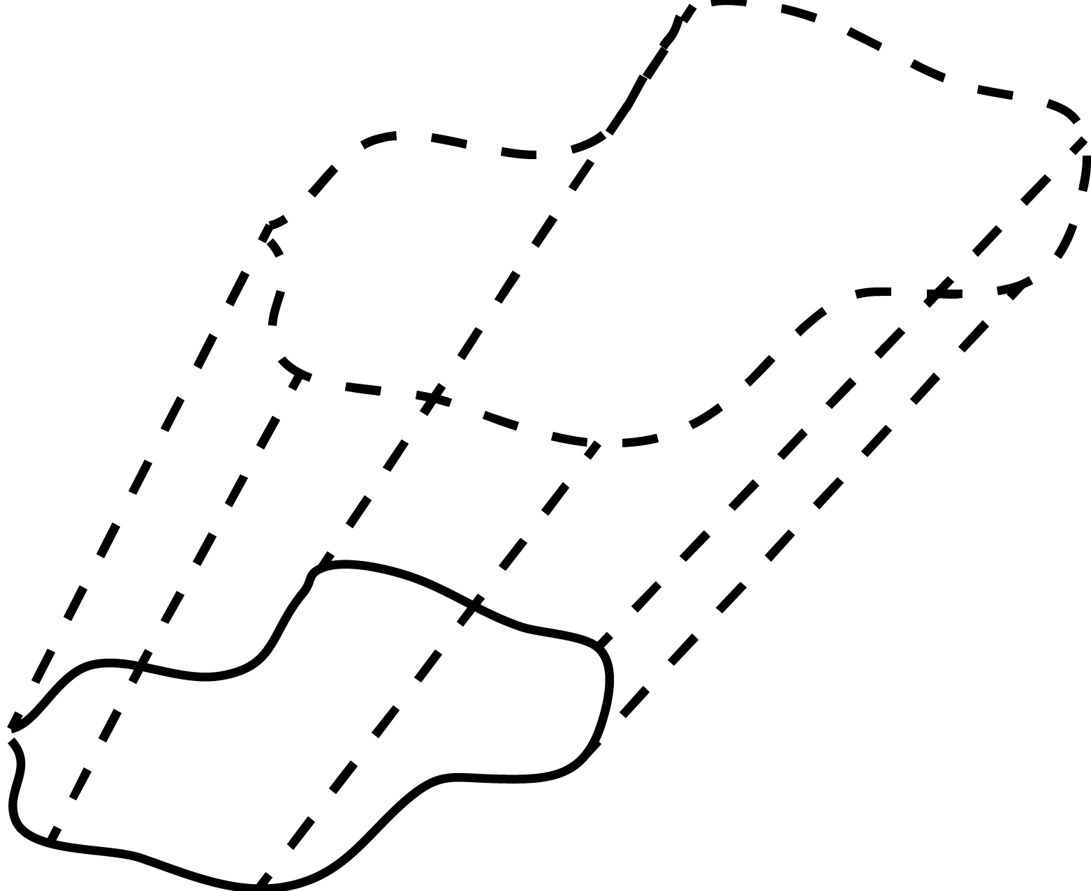
What Research Axis? N(Analytics) = ε
Interaction
Specifying Points
Specifying Regions of Interest
Visualization

Slide 23
Specifying Points (Springer Virtual Reality, 2021) Mickaël Sereno, L. Besançon, T. Isenberg
Anchor virtual objects
Probe data
Show a point

Slide 24
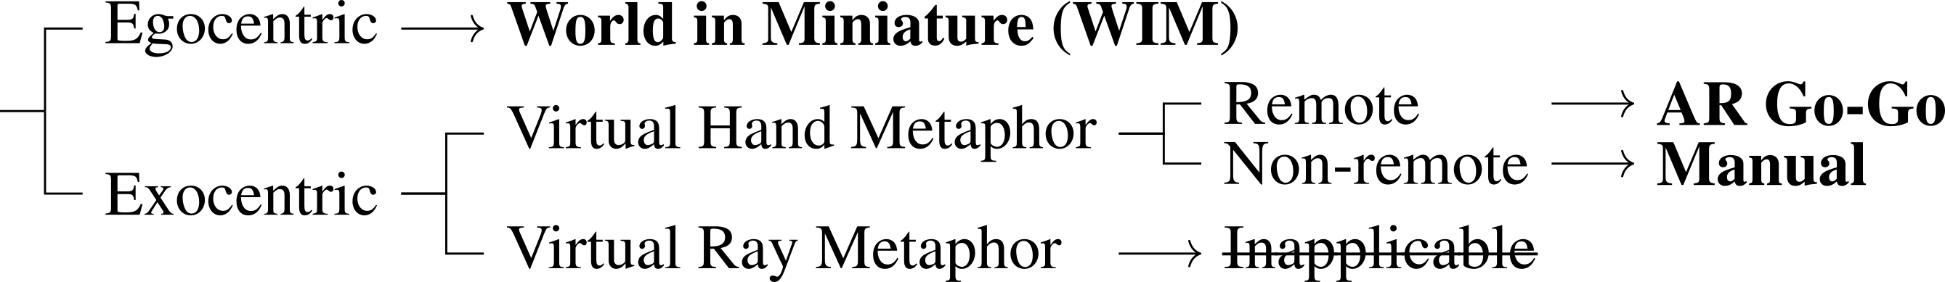
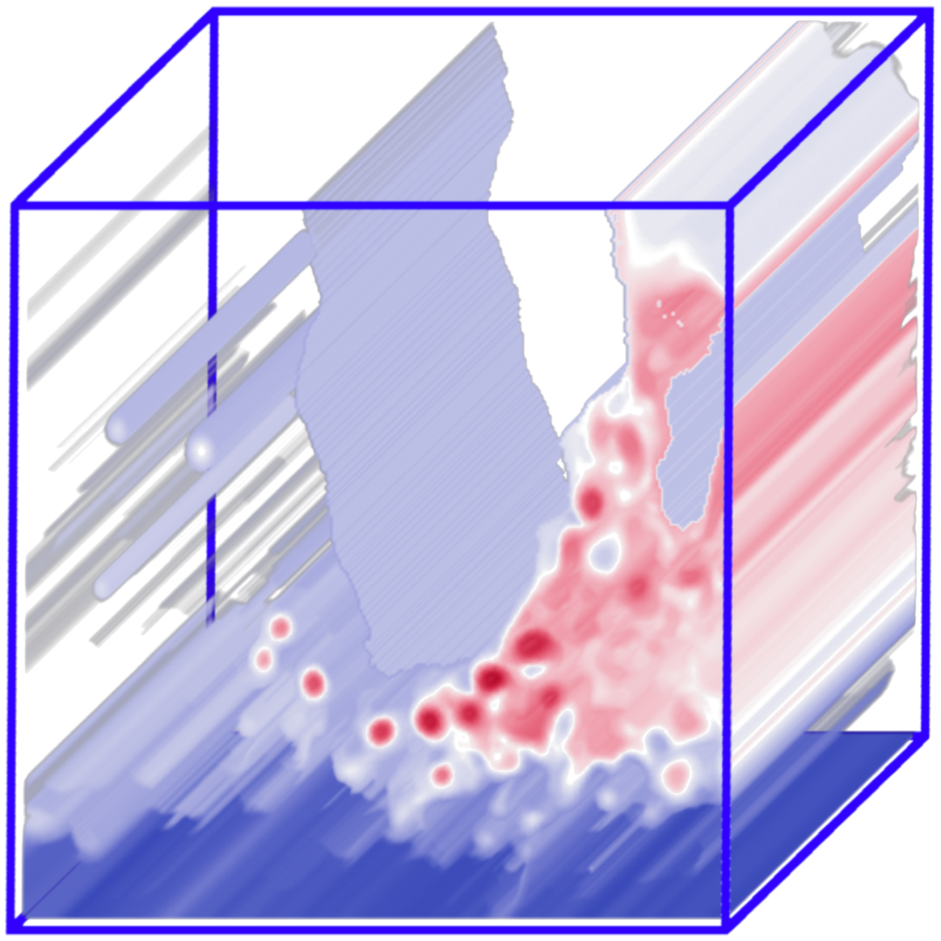

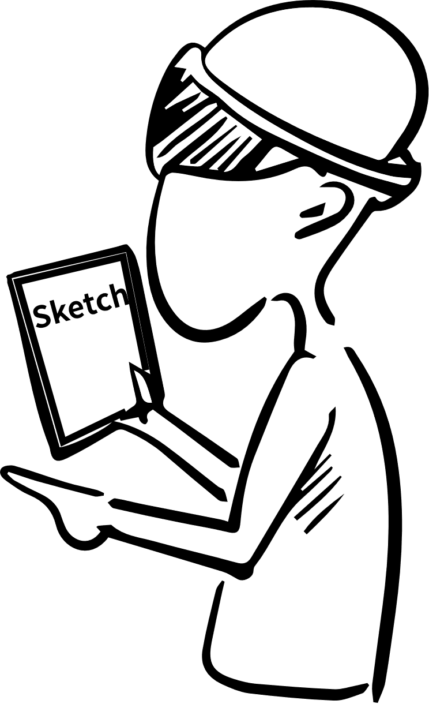
Specifying Points (Springer Virtual Reality, 2021) Mickaël Sereno, L. Besançon, T. Isenberg
Poupyrev et al., “Egocentric object manipulation in virtual environments: Empirical evaluation of interaction techniques,” 1998

Slide 25




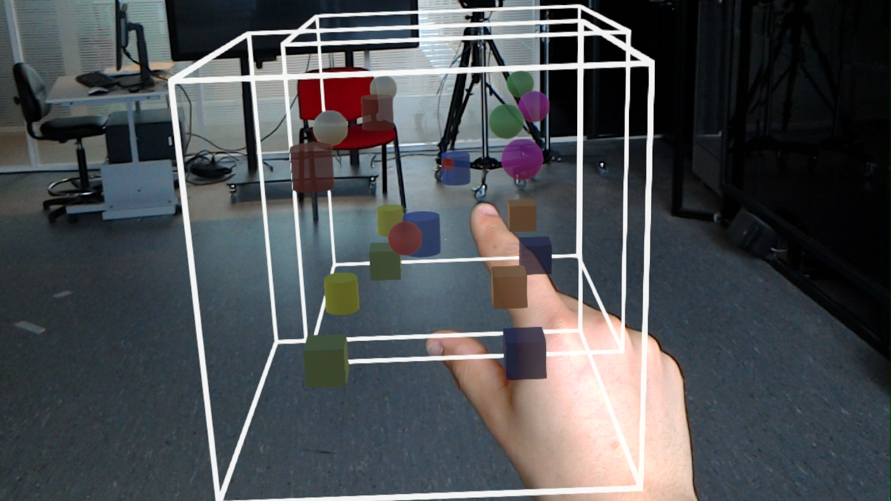
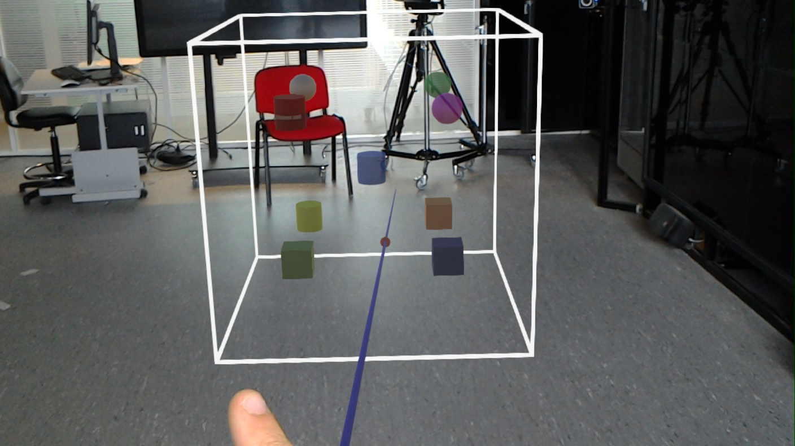
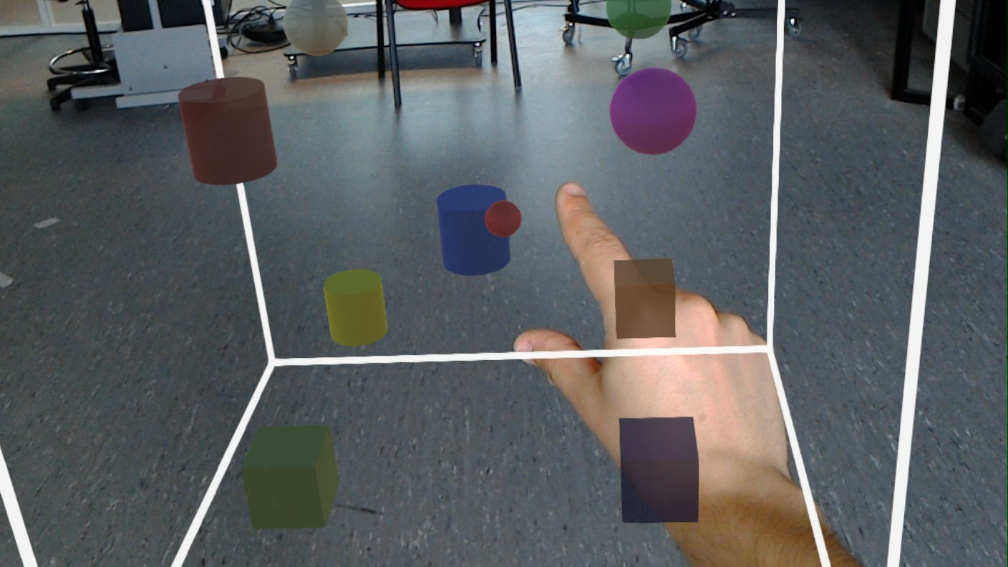
Specifying Points: The Techniques
WIM
Go-Go
Manual

Slide 26
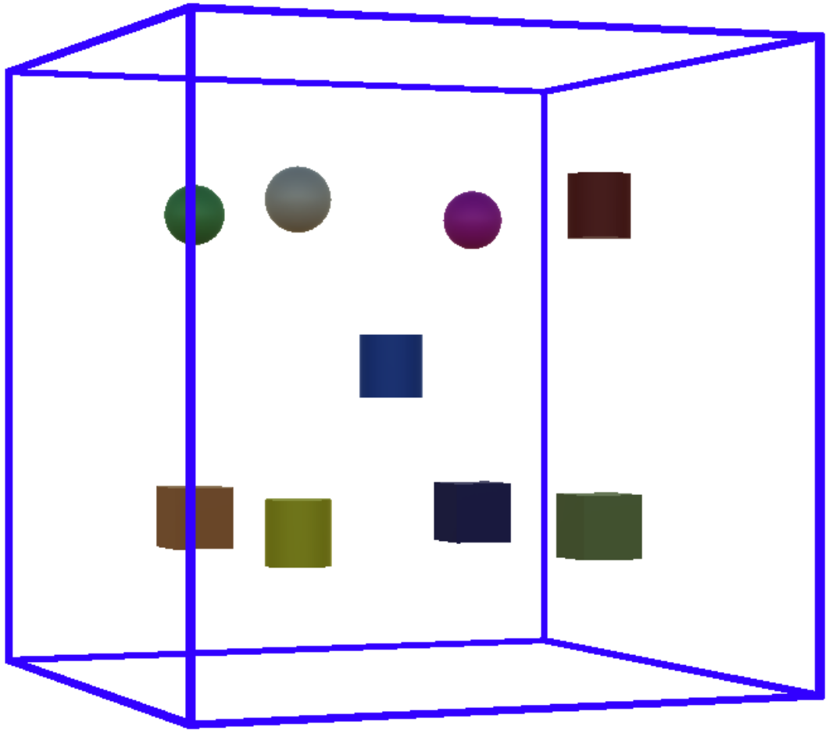
Specifying Points: « Dataset »
Abstract the type of the Dataset
Does not require knowledge

Slide 27
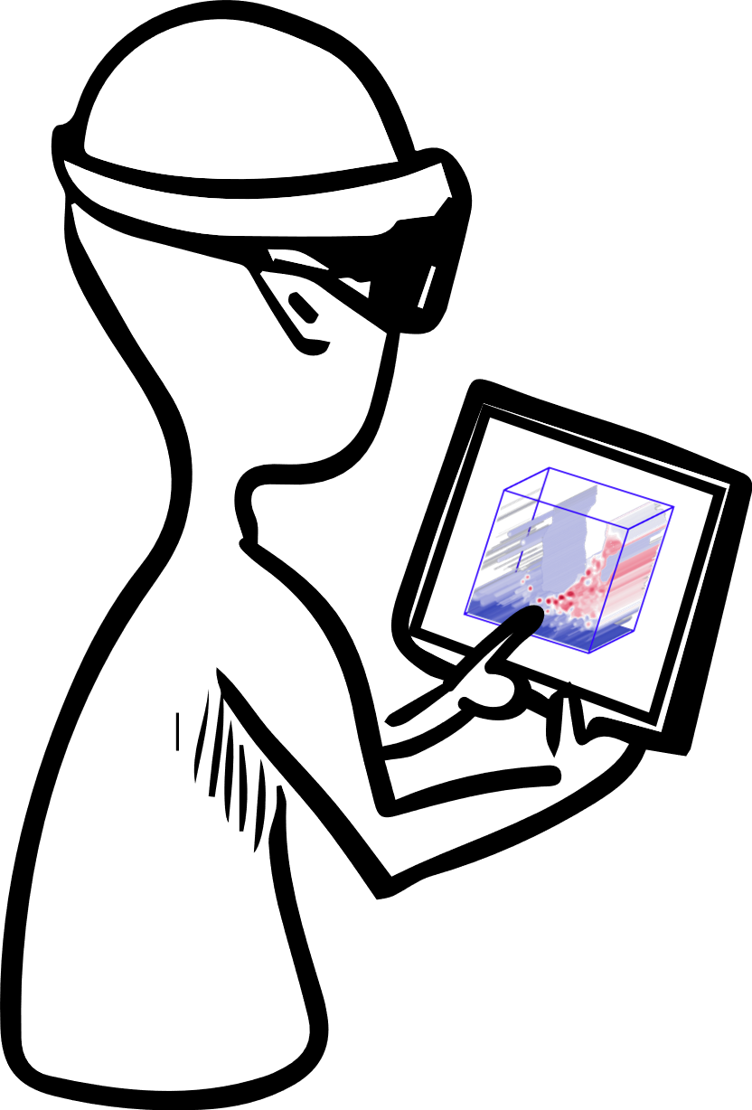
Specifying Points: Tasks 12 pairs (= 24) of Participants. Within-subject.
Collaborative “Guiding” Tasks
Solo Tasks

Slide 28







Specifying Points: Measures Dependent Variables
Accuracy
Speed
Workload
Co-Presence
Understanding
Behavior

Slide 29
Specifying Points: Results
Go-Go is the slowest (solo tasks)
Go-Go is the most tiring, difficult, and stressful
Manual
WIM
Go-Go

Slide 30
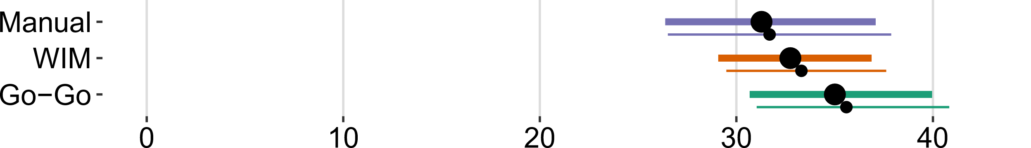
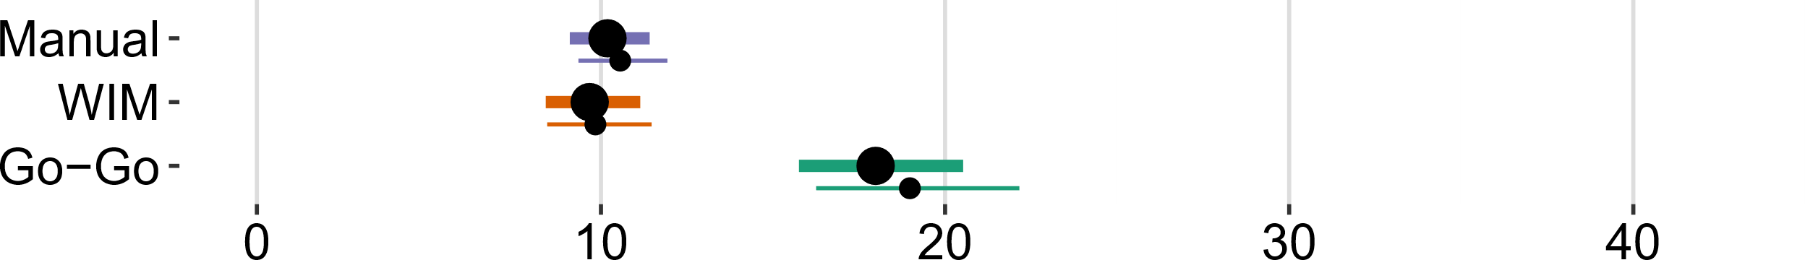
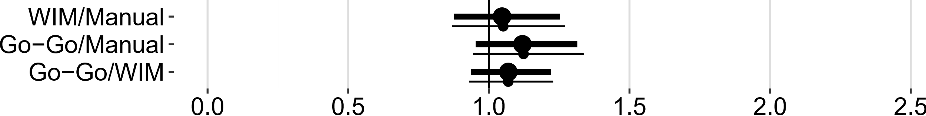
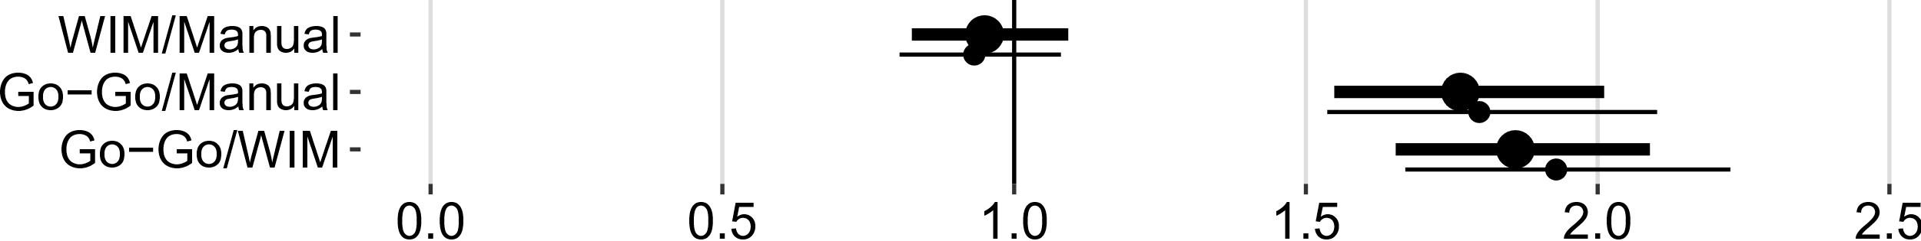
Specifying Points: Results Speed (with and without outliers). Error bars are 95% Cis
Collaborative Tasks
Solo Tasks
No evidence of a difference.
Go-Go is the slowest.

Slide 31
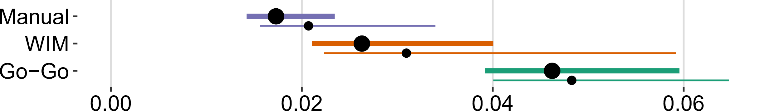
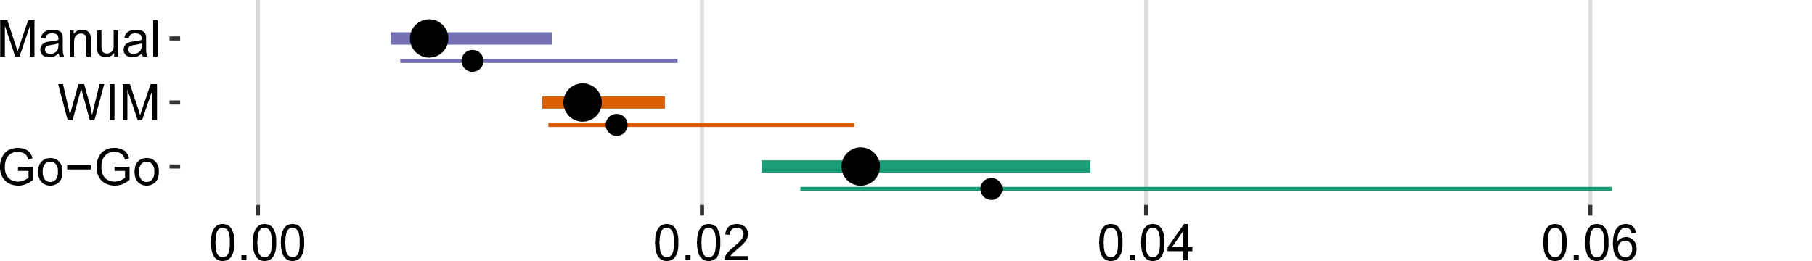
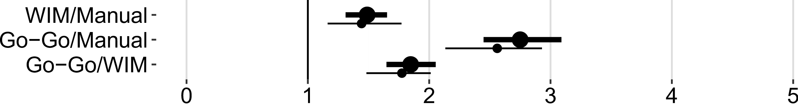
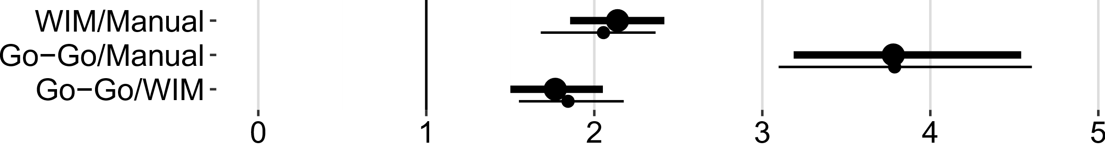
Specifying Points: Results Accuracy (with and without outliers). Error bars are 95% Cis
Collaborative Tasks
Solo Tasks
Manual is the most accurate, and Go-Go the least accurate.

Slide 32
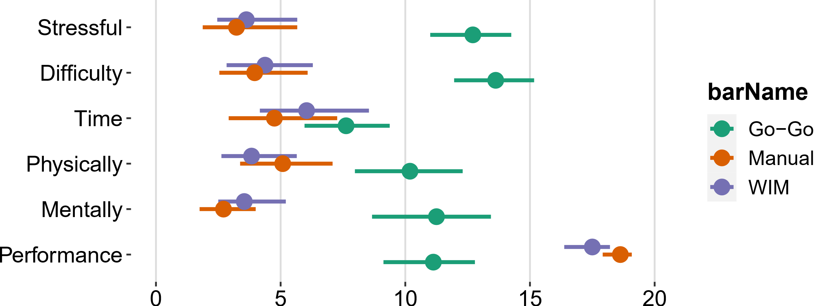
Specifying Points: Results NASA-TLX.
Go-Go is the most tiring, difficult, and stressful

Slide 33

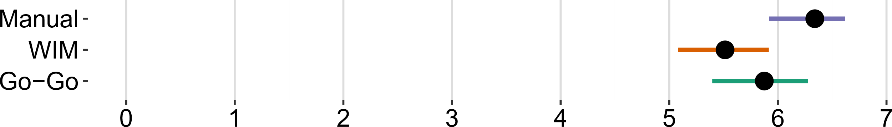
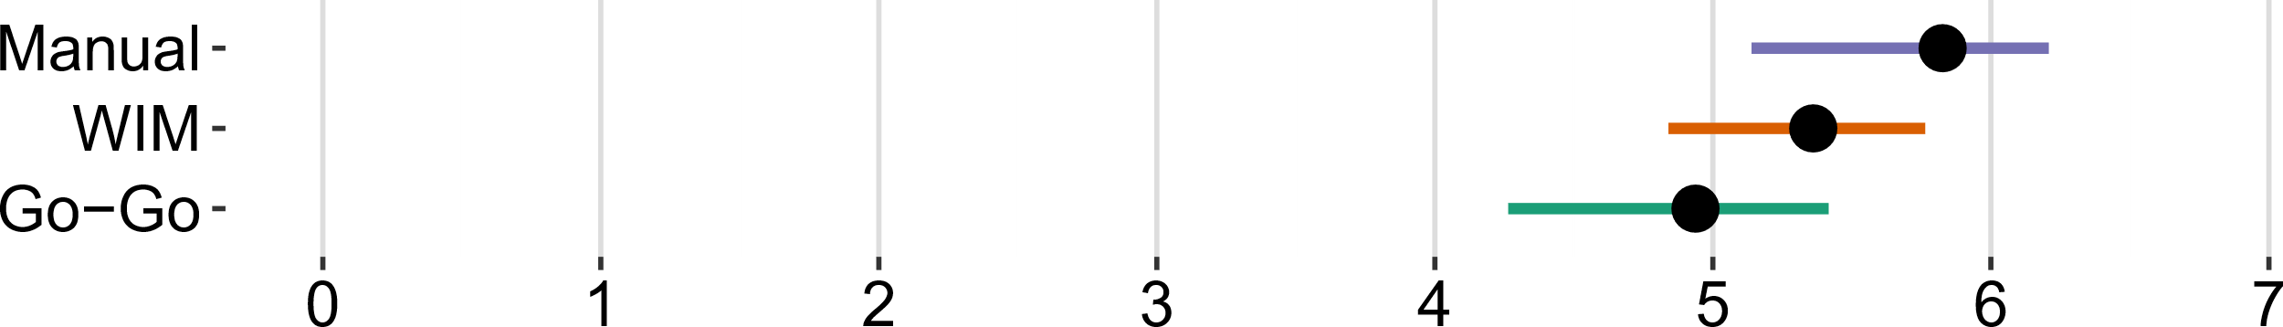
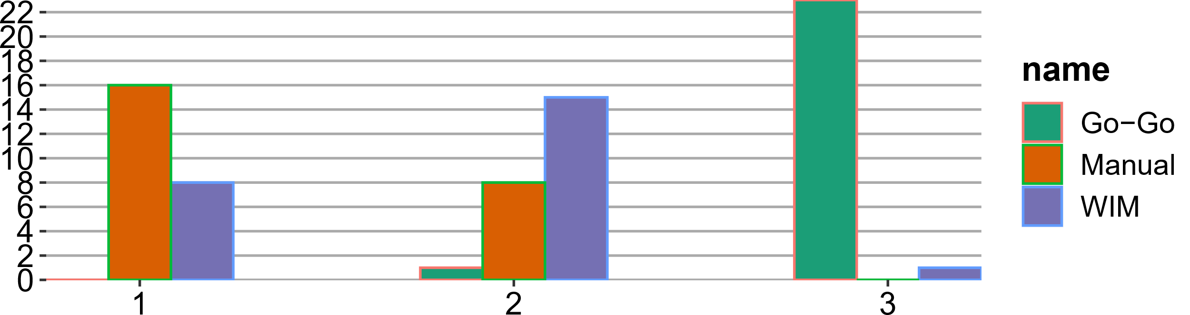
Specifying Points: Results Co-Presence, Understanding, and Preference (95% Confidence Intervals).
Co-Presence. Weak evidence that Manual feels more “together” than WIM.
Message Understanding. Weak evidence that Manual is more understandable than Go-Go.
Preferences. Manual is the most preferred, Go-Go is the least preferred.

Slide 34




Specifying Points: Conclusions
GO-GO
Good Directional Cues
Requires higher motor skills
Depth perception issue
Manual
Most preferred
But tracking conflict
WIM
Two “references” → confusion
Able to guide from Main Window
Teaching
Together
One-User
Parallel Work

Slide 35
Next Project: Specifying Points→ Specifying Regions
Points: -Extensive literature in VR -“Simple”
N users
Regions: -Less studied
-“Complex”
One user

Slide 36
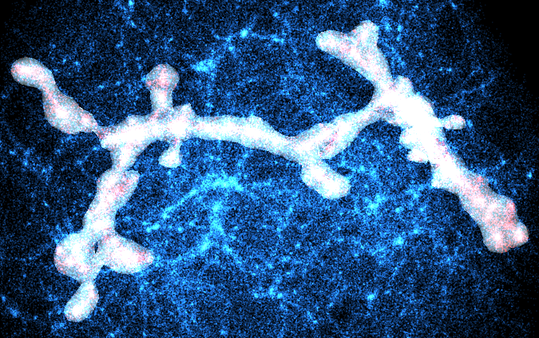
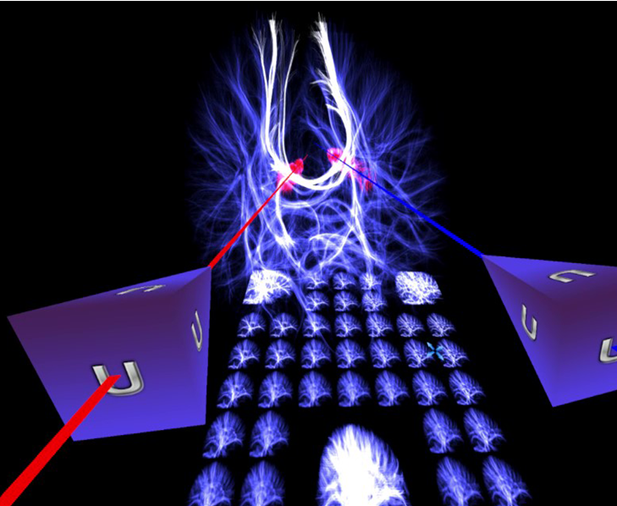
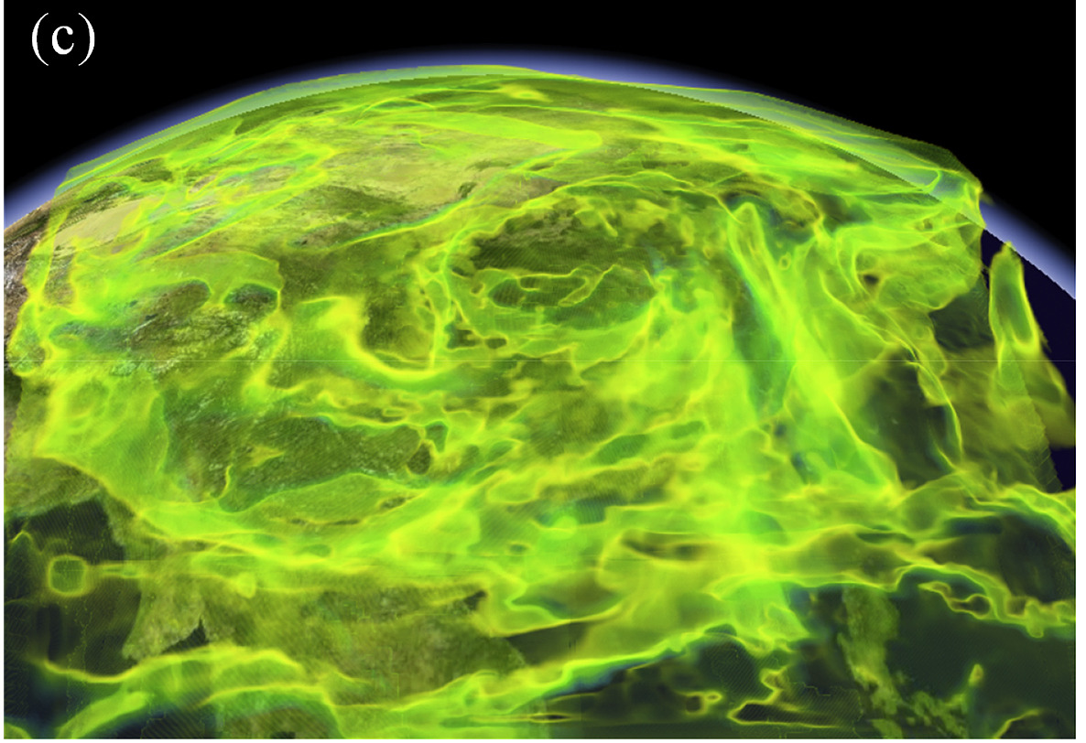
Specifying Regions A general technique
Cloud points
Paths
Scalar field
Yu et al., “CAST: Effective and efficient user interaction for context-aware selection in 3D particle clouds,” 2016
Hurter et al., “FiberClay: Sculpting three dimensional trajectories to reveal structural insights,” 2019
Zhang et al., “An efficient dynamic volume rendering for large-scale meteorological data in a virtual globe,” 2019

Slide 37
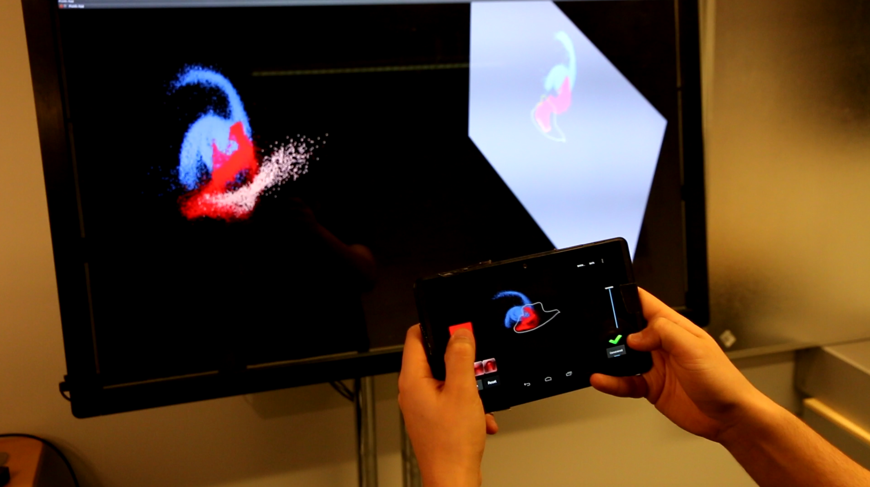
The Original Tangible Brush (2019)
Back in Time…. Tangible Brush
L. Besançon, Mickael Sereno, M. Ammi, L. Yu, T. Isenberg, ‘‘Hybrid Touch/Tangible Spatial 3D Data Selection’’, 2019

Slide 38


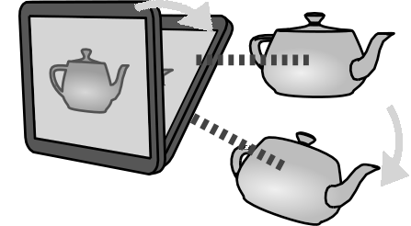
Tangible Brush, Principles

Slide 39
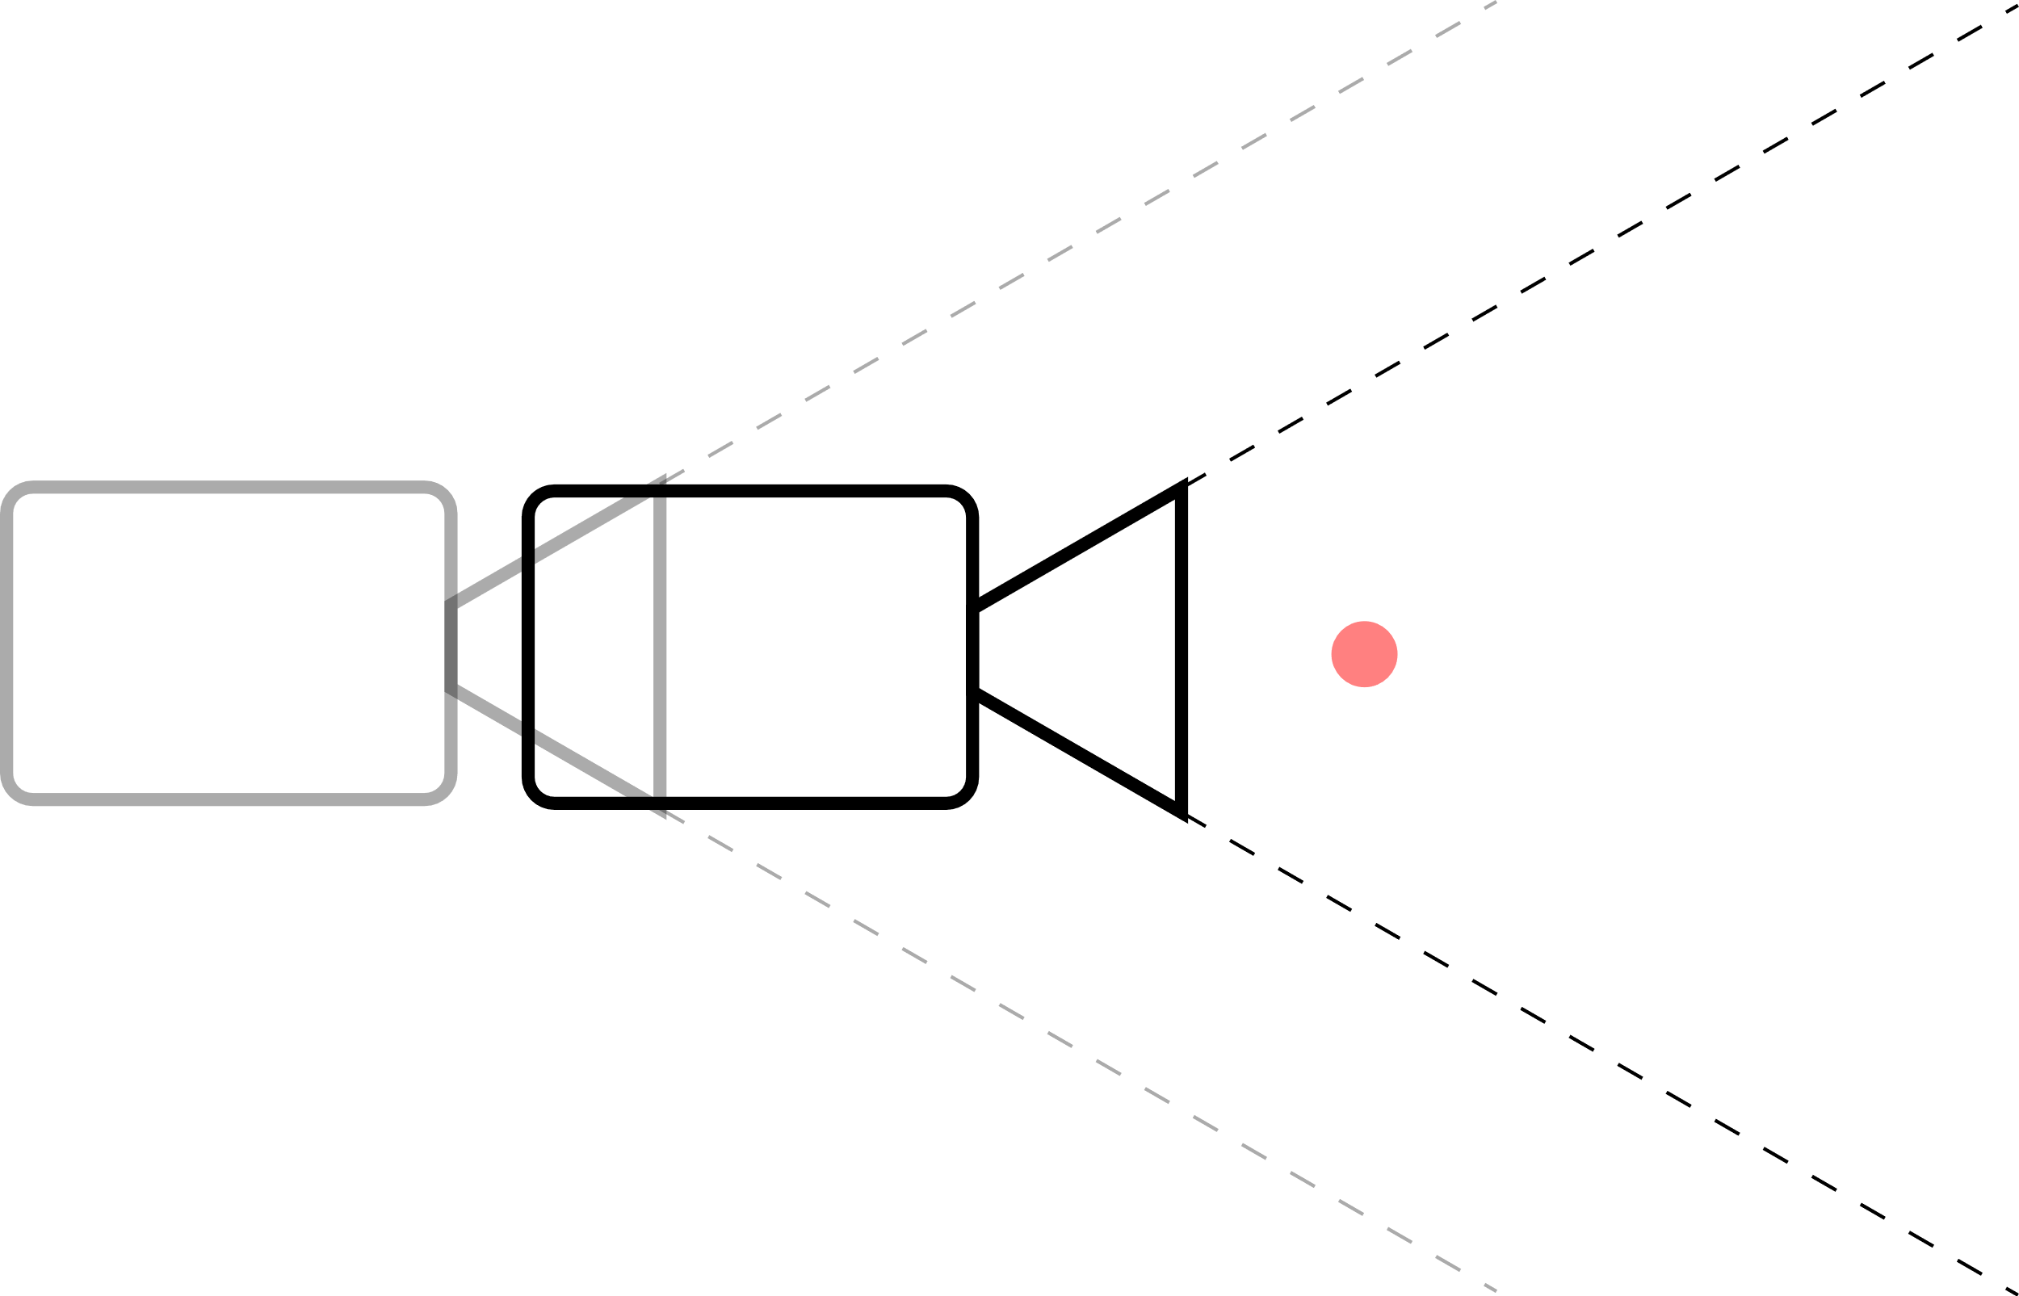

Tangible Brush, Perspective vs. Orthographic

Slide 40


Tangible Brush, Perspective vs. Orthographic
3D

Slide 41
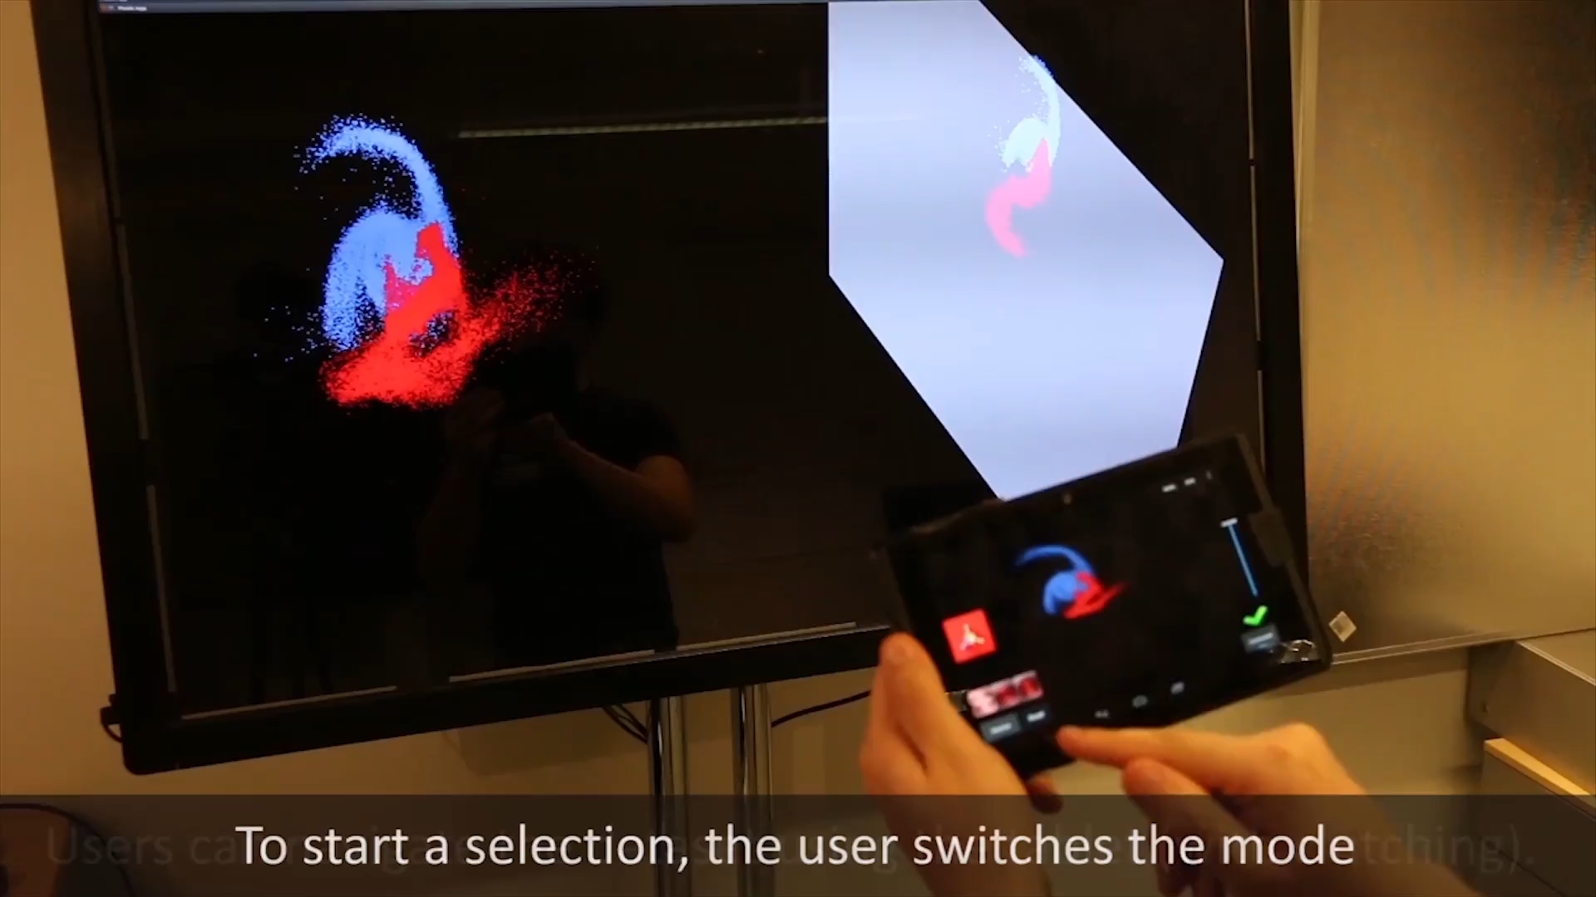
Tangible Brush, Two Screens
Perspective
Orthographics

Slide 42

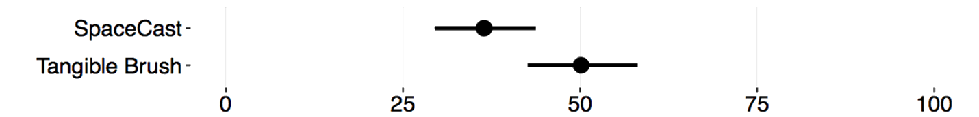
Tangible Brush, Accurate BUT Mentally Demanding
MCC score. Tangible Brush more accurate
Total Workload. Tangible Brush more demanding

Slide 43
Specifying Regions – From 2D to 3D Mickaël Sereno, S. Gosset, L. Besançon, T. Isenberg
Stéphane Gosset, Intern
Decoupled
Coupled

Slide 44
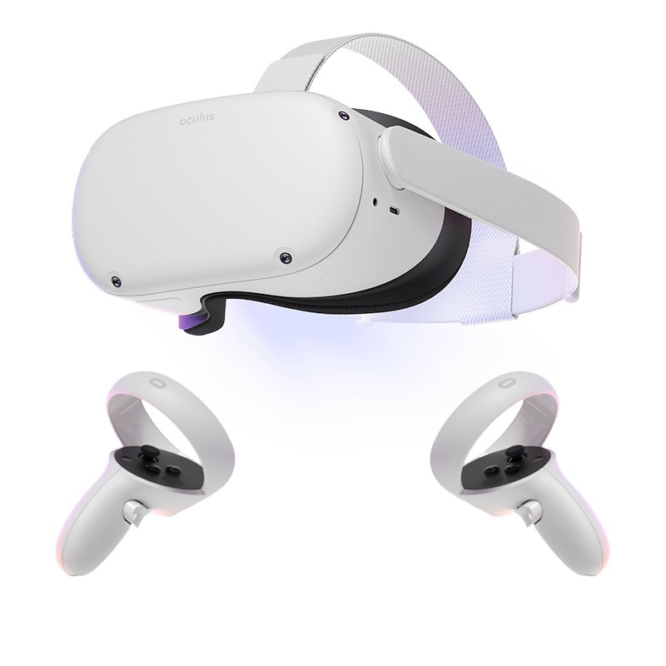
Specifying Regions – Enable Tangible Interactions
VICON
Mobility?
TCP/IP
Oculus Quest, Facebook!
Common 3D Space: HoloLens API – Spatial Anchoring

Slide 45

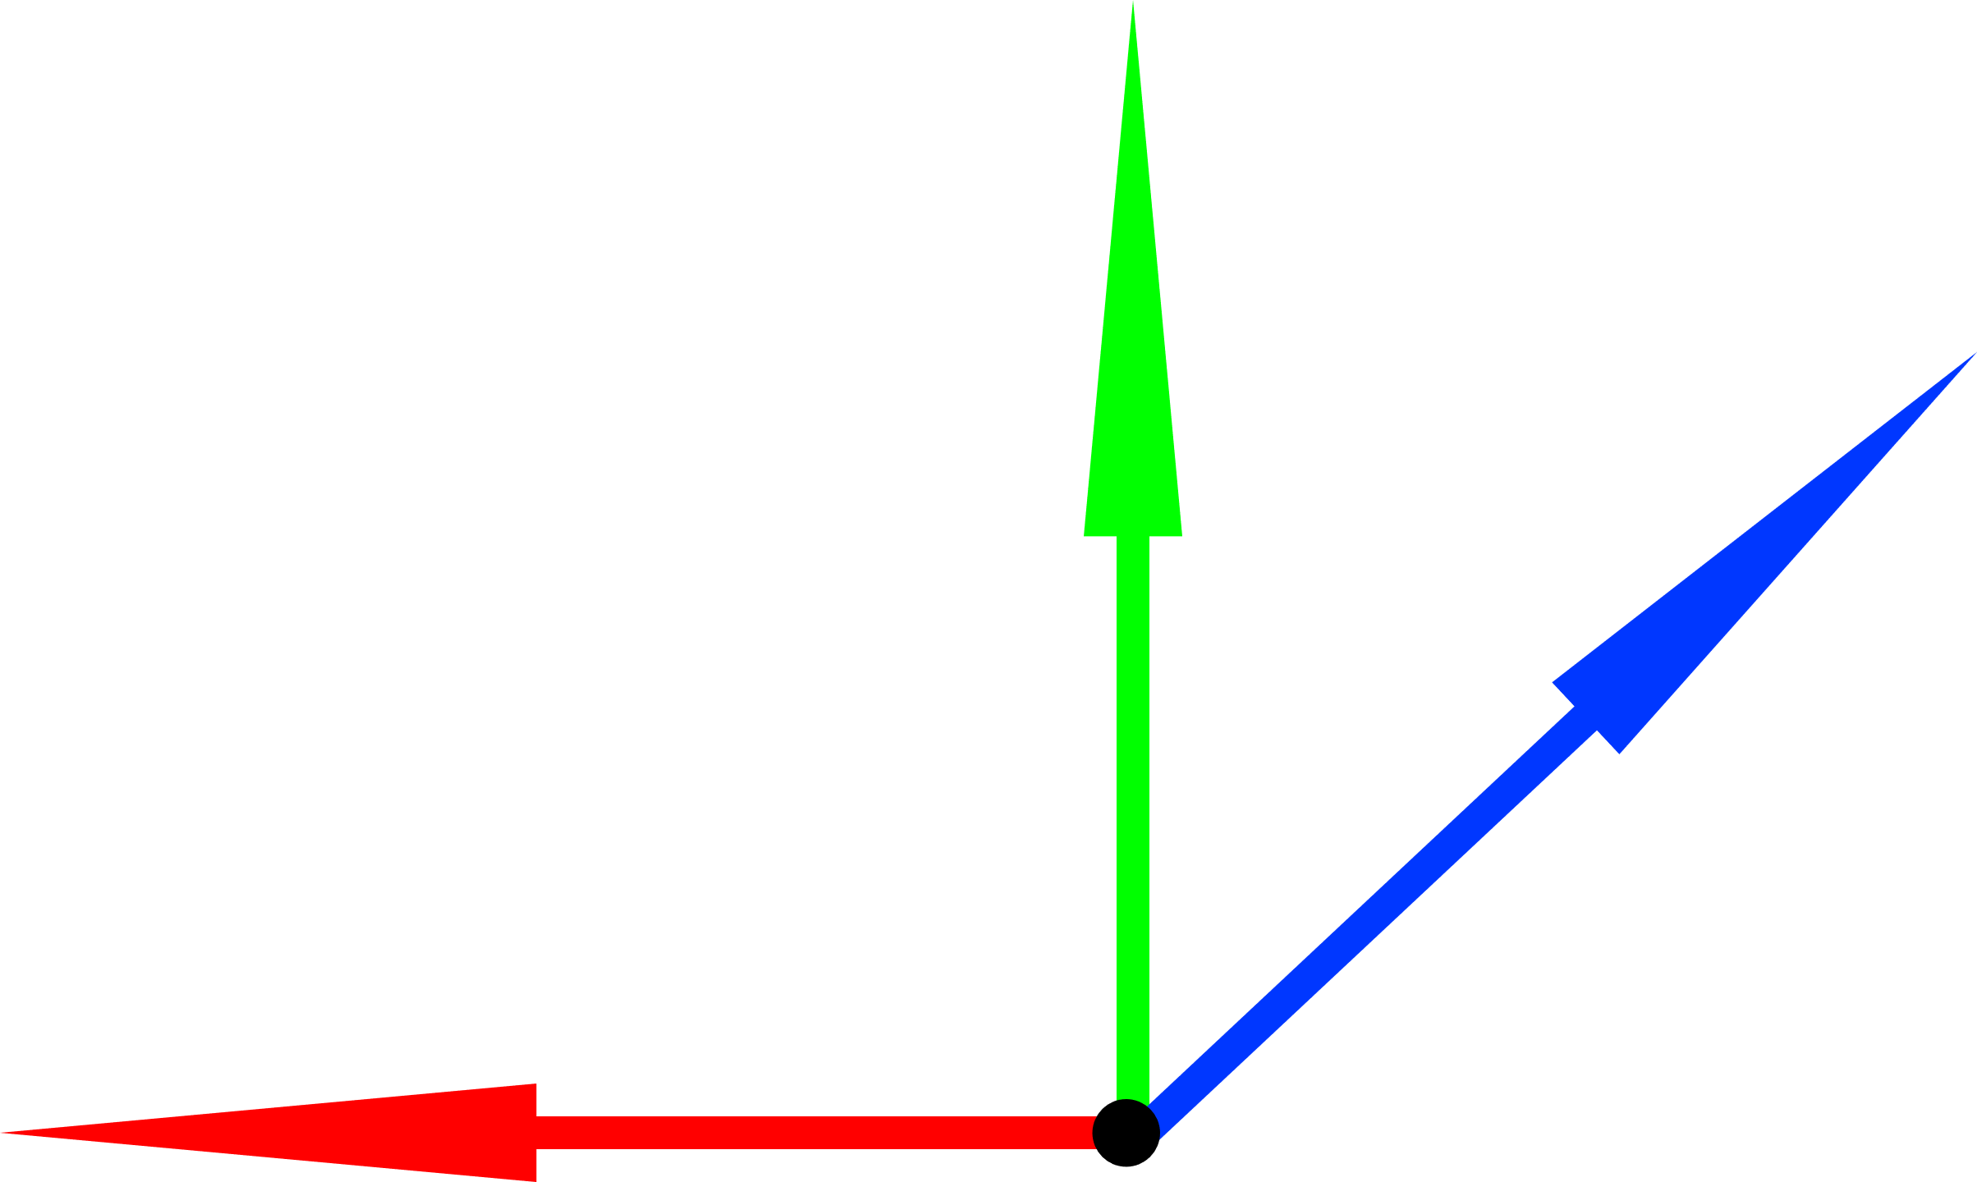

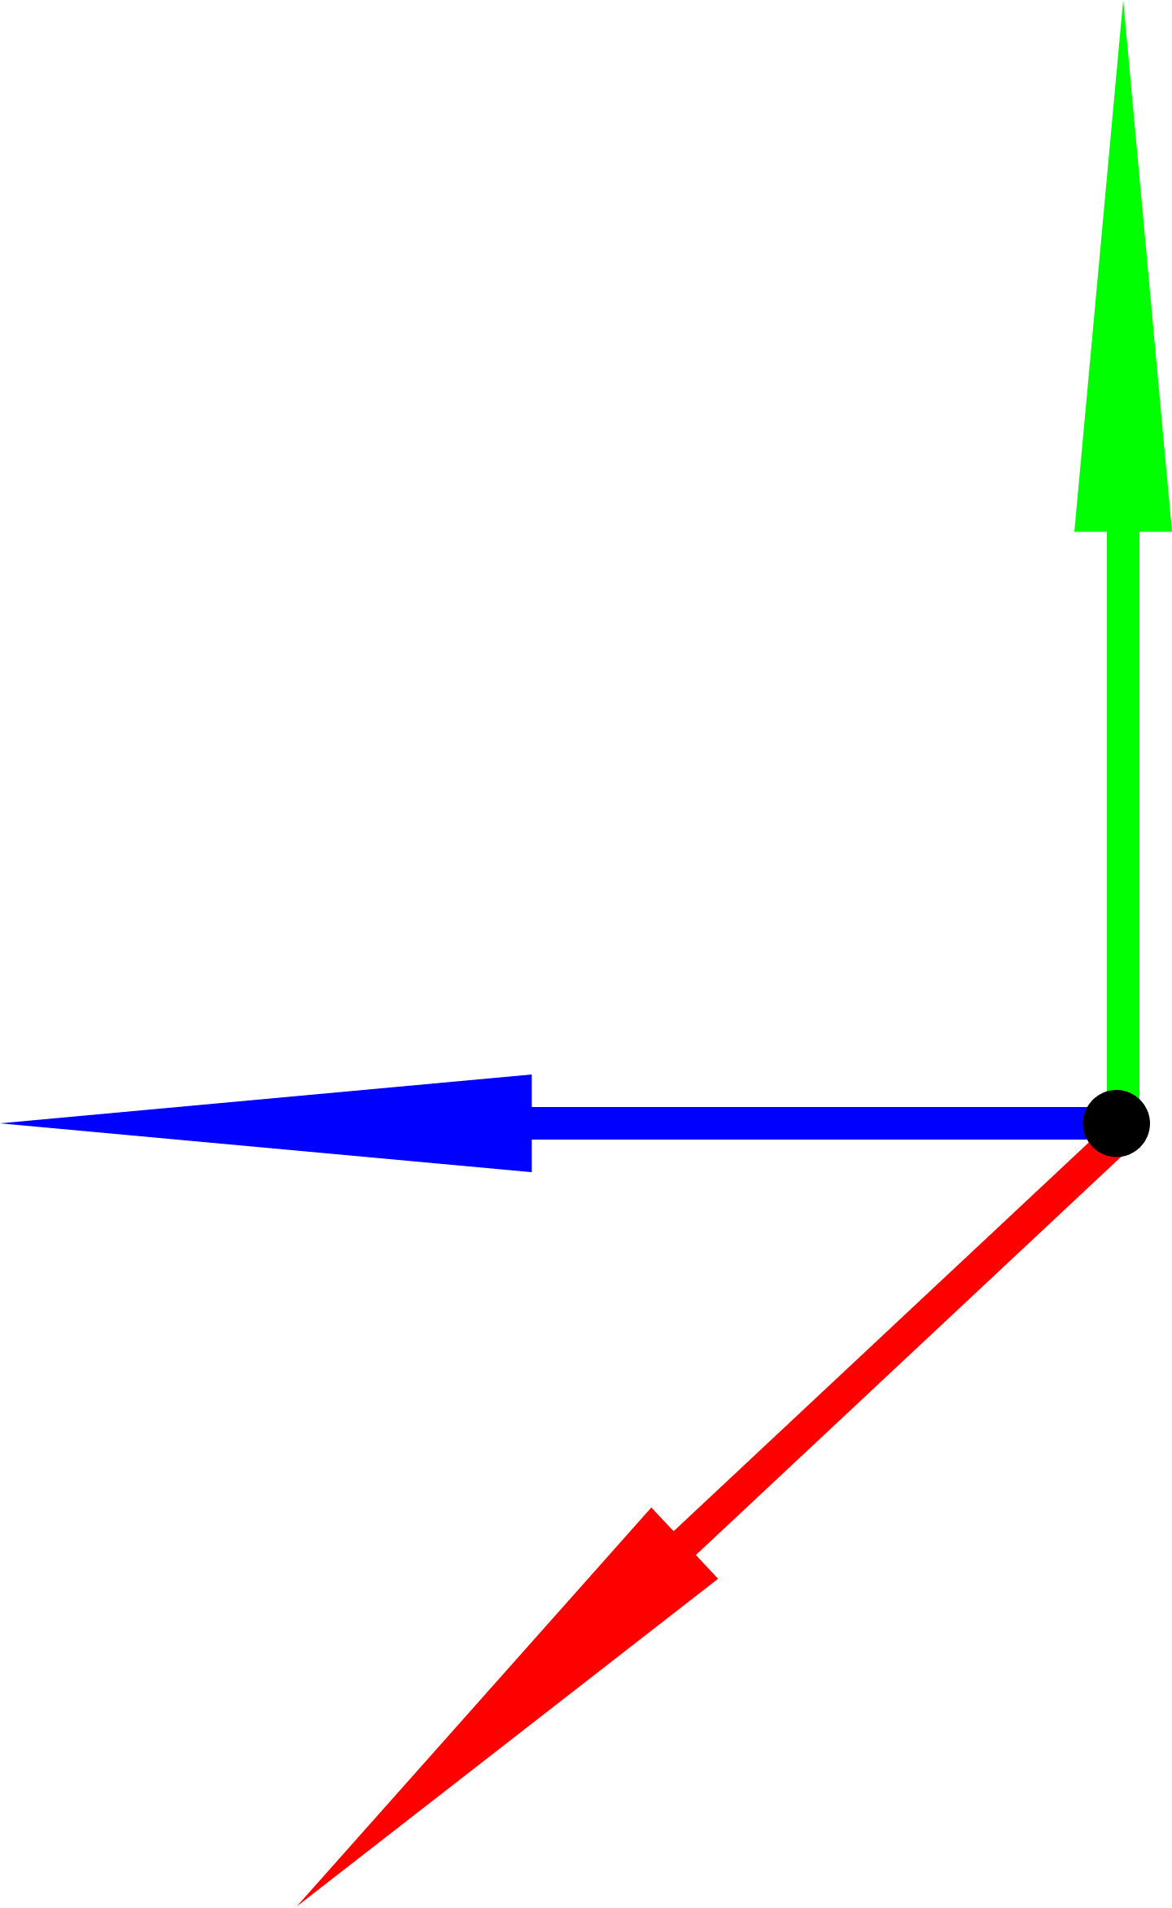
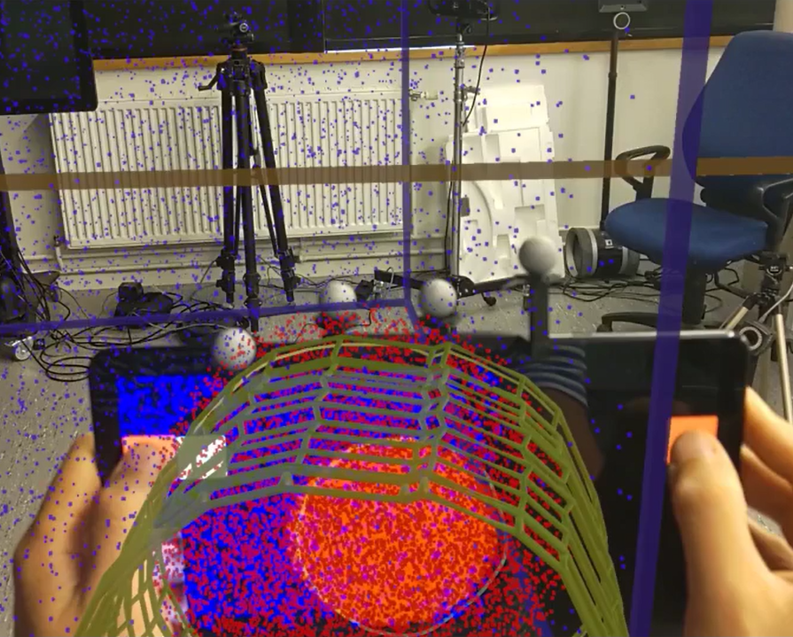
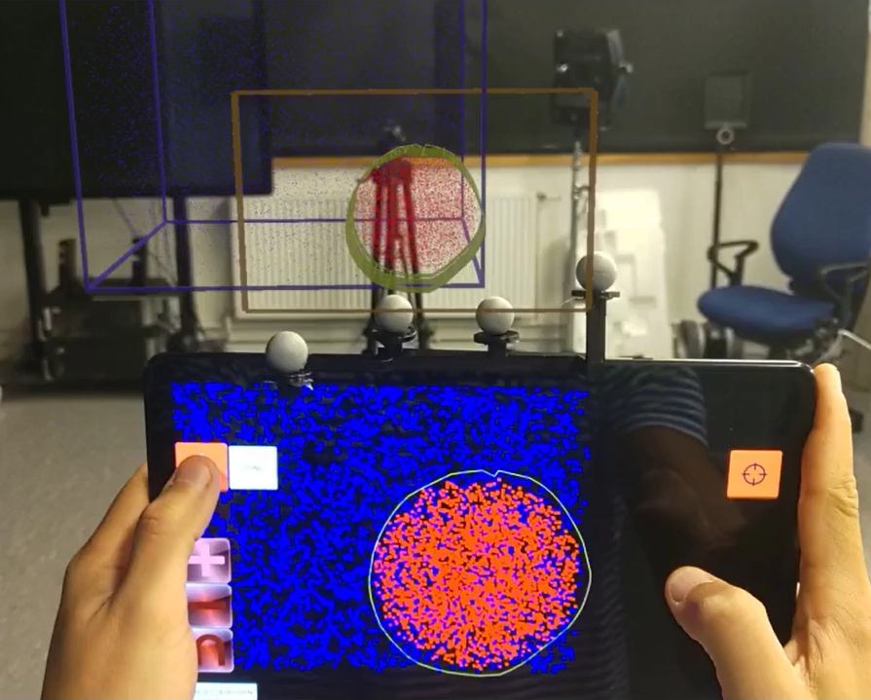


Specifying Regions – Mappings
Naïve Approach
Relative-Aligned
Relative-Full
Relative Mappings

Slide 46





Specifying Regions – Directness
Bruckner et al., “A model of spatial directness in interactive visualization,” 2019
(3D)
(3D)
(3D)
(2D)
Naïve Approach
=
=
=
Naïve Approach
Indirect
Relative-Aligned
=
=
Aligned
Relative-Aligned
Indirect
Relative-Full
=
Relative-Full
Aligned

Slide 47
Specifying Regions – Scaling Issue
Physical tablet: 10.5’’
Virtual tablet: modular

Slide 48

Specifying Regions – HMD Interface

Slide 49

Users can use unconstrained movements…

Slide 50

Specifying Regions – Unconstrained

Slide 51


Slide 52

Specifying Regions – User Study
Naïve Approach
Relative-Aligned (position)
Relative-Full (position + rotation)
3 mappings
Relative Mappings
1 mapping

Slide 53





Specifying Regions – Two User Experiments Within-Subject. Select Red, do not select Blue
2 X 18
AR alone
“Best” AR vs. 2D
VS.
Constrained
Real Use-Case
Unconstrained

Slide 54

Specifying Regions – Experiment (AR)
Relative-Full: most accurate (But small size-effect)
Relative-Aligned: required lowest effort
Relative-Aligned: Preferred
Main Focus:

Slide 55


Specifying Regions – Experiment (AR)
Time-Completion Tasks. No strong evidence.

Slide 56




Specifying Regions – Experiment (AR)
MCC score. RF is the most accurate
Raw Nasa-TLX score. RA felt most performant with lowest effort.

Slide 57






Specifying Regions – Experiment (AR)
Constraint/Total operations. RF calls for more constrained movements (pair-wise analysis).
OR
AND
NOT

Slide 58

Specifying Regions – Experiment (AR)
Constraint/Total operations. RF calls for more constrained movements.
OR
AND
NOT

Slide 59


Specifying Regions – Experiment (AR)
Participants’ focus. The AR view is the main focus.
Participants’ preference ranking. Participants preferred RA.

Slide 60
Specifying Regions – AR – Overall
Relative-Aligned
Relative-Full
Naïve Approach
Relative Mappings

Slide 61
Specifying Regions – Experiment (AR vs. 2D)
vs.
: Similar
:

Slide 62


Specifying Regions – Experiment (AR vs. 2D)
Time-Completion Tasks. No strong evidence.

Slide 63




Specifying Regions – Experiment (AR vs. 2D)
MCC score. Different results.
Constraint/Total operations.
Participants understood better the 3D visualizations in AR.

Slide 64


Specifying Regions – Experiment (AR vs. 2D)
Raw Nasa-TLX score. AR strongly reduces the users’ workload.

Slide 65


Specifying Regions – Experiment (AR vs. 2D)
2D
3D
Near clipping plane
Participants’ focus. Switch from the Tablet to the AR view

Slide 66


Specifying Regions – Experiment (AR vs. 2D)
2D
3D
Near clipping plane
Participants’ focus. Switch from the Tablet to the AR view
Usefulness of the External Screen. The HMD supports users more than the 2D screen

Slide 67

Specifying Regions – Experiment (AR vs. 2D)
Participants’ ranking. 1 is best.
Participants largely preferred AR over 2D.

Slide 68
Specifying Regions – Behaviors (Naïve Approach)
Conflict between tablet and HMD
Lack of Scene-overview

Slide 69



Specifying Regions – Behaviors (Relative-Aligned)

Slide 70


Specifying Regions – Behaviors (Relative-Full)

Slide 71
Specifying Regions – Overall
Relative-Aligned
Relative-Full
Naïve Approach
Relative Mappings
Workload
Preference

Slide 72
Specifying Regions – Future Work
Test for different rotations (RF)
45°
90°
180°
Test the human’s ability to handle multiple degrees of freedom
By studying trained users?

Slide 73
Direct vs. Indirect Interactions
RQ4: As a side effect of those studies, what are the main benefits and limitations of direct interaction mappings compared to remote ones?
Points: Direct
Regions: Indirect
Relative-Aligned
Relative-Full
Relative Mappings

Slide 74



Direct vs. Indirect Interactions Users’ preference and general performance
Low
Density
High
Low
Overview
High
Low
General Accuracy
High

Slide 75


Interactions + Visualization
Interactions
Specifying points
Specifying Regions
Visualization
Private / Public / Subjective Space

Slide 76


Private Views in Augmented Reality
Mickaël Sereno - AVIZ

Slide 77





An Initial Subjective View – Definition and Problem
RQ5: What are the subjective views advantages and disadvantages? Which interaction techniques and visualizations support users?
Spatial Object
User A
User B
Do you see that?
?

Slide 78





Visualization Context – Initial Designs
Layout Stacking
Linked View
Layout Stacking + Linked View
Dissociated
Associated
Dissociated
Associated
Common Object

Slide 79

Subjective Views – Examples

Slide 80


Subjective Views – Examples

Slide 81

How to Study This? A Real Use-Case Burkard Baschek, Oceanographers, HZG, Germany
Need Datasets
Need Real Scenarios
Need Exploration Tools

Slide 82

How to Study This? A Real Use-Case Burkard Baschek, Oceanographers, HZG, Germany
Meeting with 5—10 persons
Issues to:
explain results
create new visualizations

Slide 83


Description of the Environment – AR Headsets
Shared Coordinate
Visualize multiple visualizations
Handle spatial interactions

Slide 84

Description of the Environment – Tablets
Handle opened visualisations
Handle time-components
3D Transformations (FI3D Widgets)

Slide 85


Description of the Environment – Tablets
Open Datasets / “Annotations”
Handle visual parameters (transfer functions, clipping, etc.)
1D
N^{th}D / PCP

Slide 86


Description of the Environment – Tablets
Handle “Canvas” annotations
Not fully functional
Handle 2D data

Slide 87



Logged Annotation – Path data
D1
D2
. . .
D_{n}
Longitude | Latitude | Depth | Temperature | Pressure | Salinity | Velocity
X | Y | D1 | T1 | P1 | S1 | V1
X | Y | D2 | T2 | P2 | S2 | V2
X | Y | … | … | … | … | …
X | Y | D_{n} | T4 | P4 | S4 | V4
… | … | … | … | … | … | …

Slide 88

Logged Annotation – Path data

Slide 89

Subjective Views – Examples (Tablets)

Slide 90

Global Software – Informal Study
2
Dataset: Cabo Verde Area
Resolution: 370 X 280 X 50 (> 5 Millions)
Variables:
Temperature
Salinity
Velocity:
Latitude
Longitude
Magnitude

Slide 91
Global Software – Informal Study
2
Main Events:
Personal Physical Space: “This is my space, go elsewhere”
Separation of Output and Input: Passive vs. Active Users
First time they look at the 3D structure
Did not look at each other
Did not move around

Slide 92
Takeaway messages Contributions: General understandings of AR-HMDs + Tablets
New AR-Headsets + Tablets Environments
Classical Desktop Environments
ParaView
Can be both complete and standalone

Slide 93


Takeaway messages Contributions: General understandings of AR-HMDs + Tablets
Pros | Cons
3D Interactions Tangible Hand 3D View Decouples 2D Interaction and 3D Rendering | 2D interface Computing power Touch understood as mid-air gestures Visibility conflicts
Visualization Interaction
Collaborative
Physical Space

Slide 94
Takeaway messages Contributions: General understandings of AR-HMDs + Tablets
Solo
Pre-process and explore data on computer-based environment
or
Collaboration
Share main insights
Discuss
Explore alternatives

Slide 95
What is Missing?
User studies with domain experts:
Usability
Subjective Views

Slide 96
Credits
Art: Yumin Hong (https://housenever.github.io/)
Data: Helmholtz-Zentrum Hereon, Germany
Code: https://github.com/MickaelSereno/SciVis_Server

Slide 97
Publications
Accepted Full Papers:
Mickael Sereno, L. Besançon, and T. Isenberg, “Point specification in collaborative visualization for 3d scalar fields using augmented reality,” Springer Virtual Reality, 2021, to appear
Mickael Sereno, X. Wang, L. Besançon, M. J. Mcguffin, and T. Isenberg, “Collaborative work in augmented reality: A survey,” TVCG, 2020, to appear
X. Wang, L. Besançon, D. Rousseau, Mickael Sereno, M. Ammi, and T. Isenberg, “Towards an understanding of augmented reality extensions for existing 3D data analysis tools,” CHI, 2020
L. Besançon, Mickael Sereno, M. Ammi, L. Yu, and T. Isenberg, “Hybrid touch/tangible spatial 3D data selection,” EuroVis, 2019

Slide 98
Publications
Full Papers In Submission:
5. Mickael Sereno, S. Gosset, L. Besançon, and T. Isenberg, “Hybrid touch/tangible spatial selection in augmented reality,” EuroVis, 2022
Workshop Papers:
6. X. Wang, L. Besançon, F. Guéniat, Mickael Sereno, M. Ammi, and T. Isenberg, “A vision of bringing immersive visualization to scientific workflows,” CHI-IA, 2019
Extended Abstracts (Posters):
7. Mickael Sereno and T. Isenberg, “Subjective views in co-located augmented reality — initial design,” VIS, 2020
8. S. Gosset, Mickael Sereno, L. Besançon, and T. Isenberg, “Tangible volumetric brushing in augmented reality,” VIS, 2020
9. Mickael Sereno, L. Besançon, and T. Isenberg, “Supporting volumetric data visualization and analysis by combining augmented reality visuals with multi-touch input,” EuroVis, 2019

Slide 99
Thank You!
RQ1 How complementary can multi-touch tablets and AR-HMDs be to collaboratively explore 3D data?
RQ2 To specify points in volumetric dataset, what interaction technique(s) support(s) best users’ understanding, co-presence, and performance, in a collaborative AR environment?
RQ3 To specify regions of interest, what are the implications of a tangible multi-touch tablet where its 3D position has meanings in the AR space compared to the original Tangible Brush which decouples the input and output spaces?
RQ4 As a side effect (post-hoc research question) of the interaction modalities I studied, what are the main benefits and limitations of direct interaction mappings compared to remote ones for one-user and collaborative environments?
RQ5 What are the subjective views advantages and disadvantages during the collaboration following the modifier and appearance dimensions for volumetric scientific datasets? Which interaction techniques and visualizations support them best with regard to the users’ understanding, co-presence, and performance?

